Slide 1



Welcome to the Community College Program Day BIO 2011 Washington D.C.

Slide 2
Regenerative Medicine – Today and Tomorrow
John W. Ludlow, Ph.D.
Senior Director, process Research & Assay Development
Eighth Annual Community College Program Day BIO International Convention, Washington, DC, June 2011

Slide 3
Forward Looking Statements
Certain statements in this presentation may constitute forward looking statements within the meaning of the Private Securities Litigation Reform Act of 1995. Although Tengion believes that these statements are based upon reasonable assumptions within the bounds of its knowledge of its business and operations, there are a number of factors that may cause actual results to differ from these statements.
For instance there can be no assurance that: (i) the Company's Neo-Urinary Conduit clinical trial will not be placed on clinical hold by the Food and Drug Administration, or FDA; (ii) patients enrolled in the Company's Neo-Urinary Conduit clinical trial will not experience additional adverse events, which could delay clinical trials or cause the Company to terminate the development of the Neo-Urinary Conduit; (iii) the Company will be able to successfully enroll patients in its clinical trials, including its initial clinical trial for the Neo-Urinary Conduit; (iv) the results of the clinical trial for the Neo-Urinary Conduit will support further development of that product candidate; (v) data from the Company's ongoing preclinical studies will continue to be supportive of advancing its preclinical product candidates; and (vi) the Company will be able to progress its product candidates that are undergoing preclinical testing, including the Neo-Kidney Augment, into clinical trial and (vii) the Company will be able to obtain the capital it needs to develop its product candidates and continue its operations.
For additional factors which could cause actual results to differ from expectations, reference is made to the reports filed by the Company with the Securities and Exchange Commission under the Securities Exchange Act of 1934, as amended. The forward looking statements in this presentation are made only as of the date hereof and the Company disclaims any intention or responsibility for updating predictions or expectations in this presentation.

Slide 4
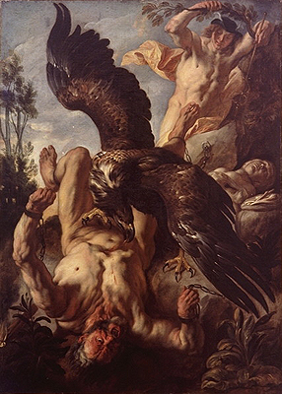
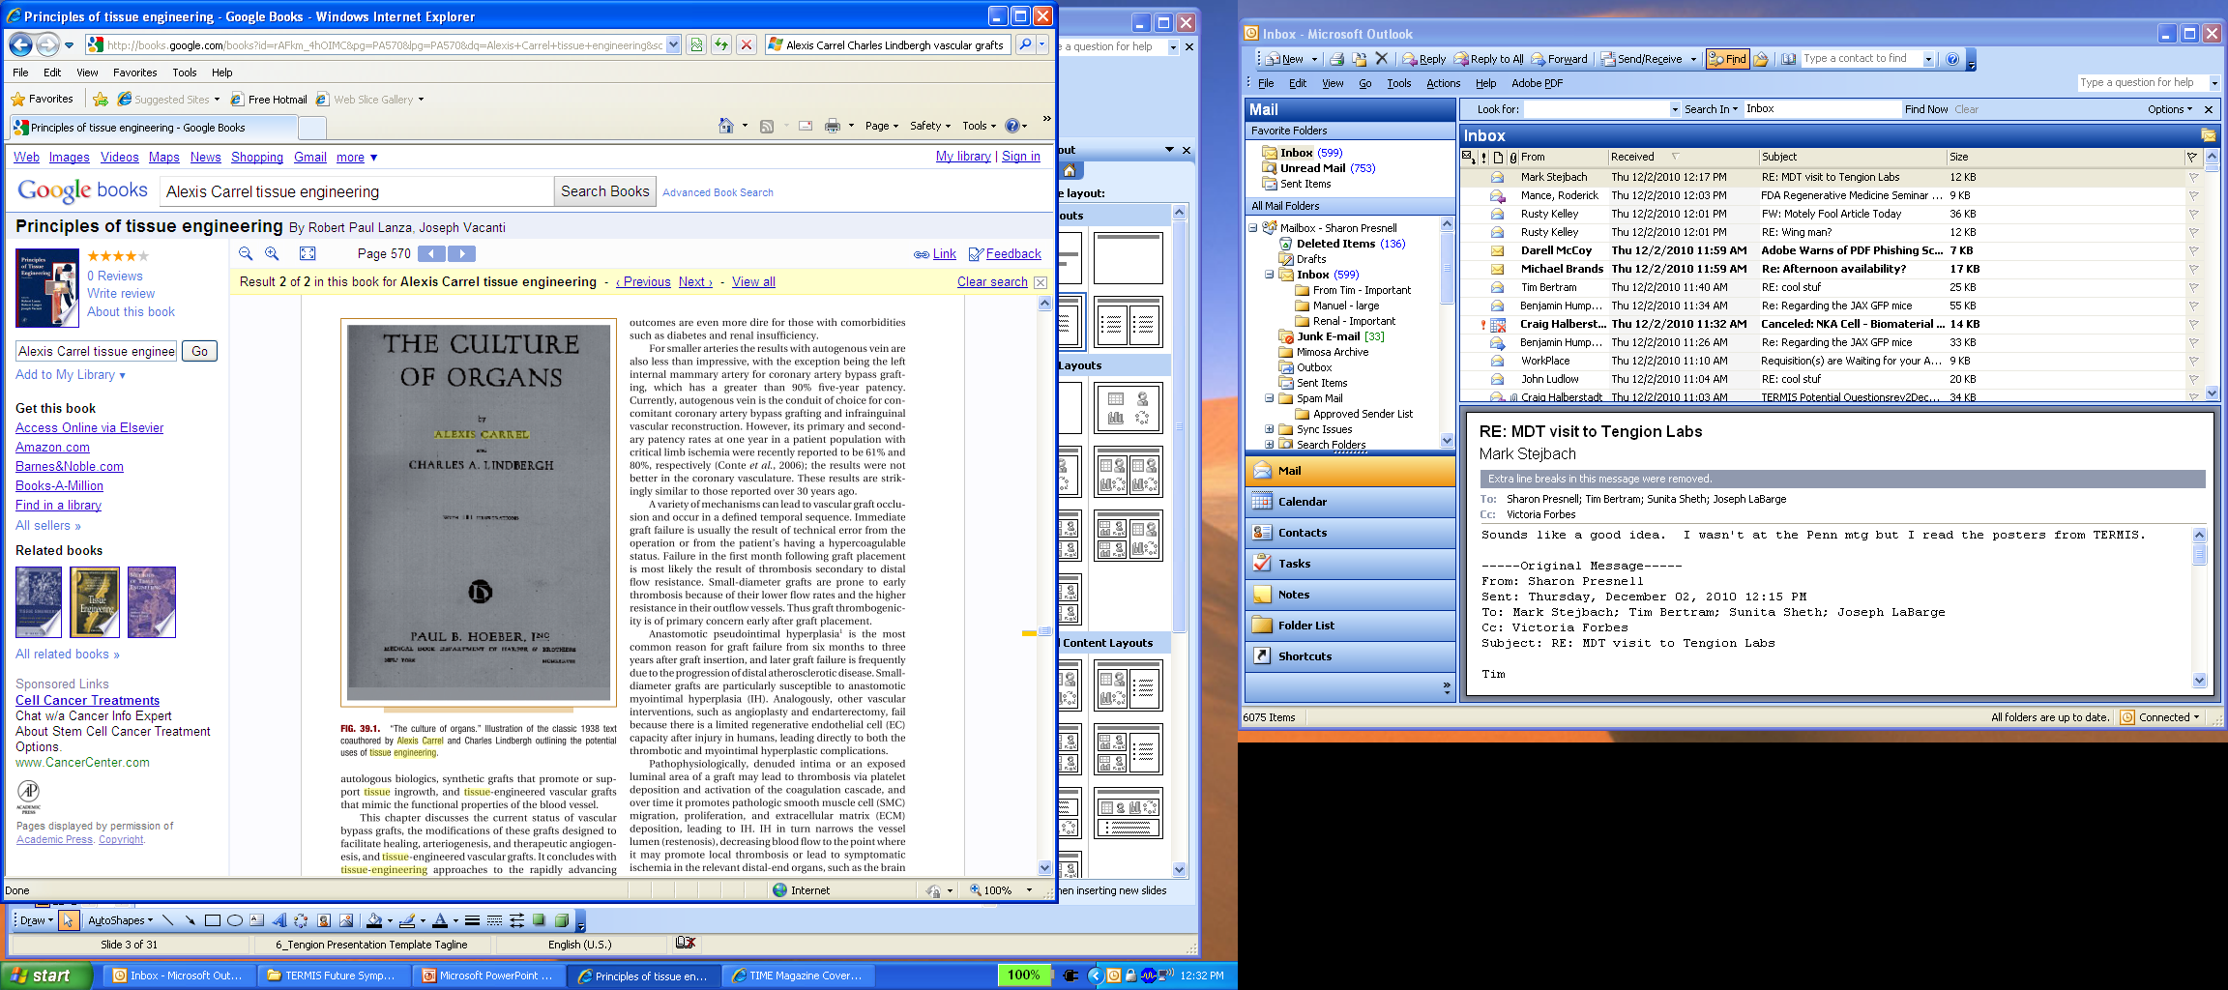
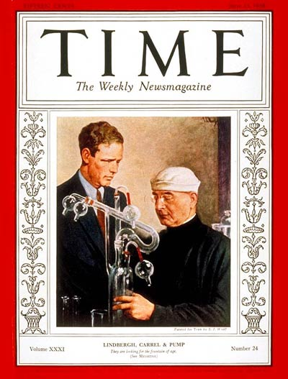
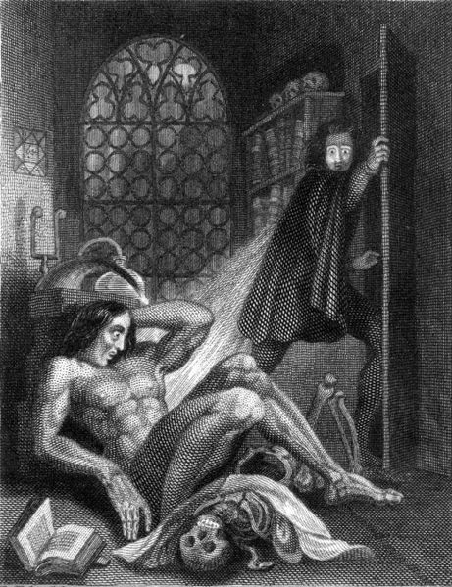
The Early History of Regenerative Medicine The past enables the present and guides the future
Prometheus Bound
Aeschylus
~458 B.C.
The Culture of Organs
Alexis Carrel &
Charles Lindbergh
1938
1954
First Kidney Transplant
1966
Small bowel submucosa as vascular grafts
T. Matsumoto, et al.
1968
First Bone Marrow Tx
1977
Allogeneic cartilage
A.E. Gross, et al.
Frankenstein
Modern Prometheus
Mary Shelley
1818
1981
Engineered skin
E. Bell, et al.

Slide 5



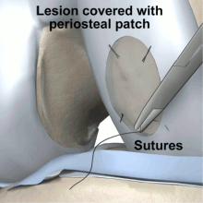
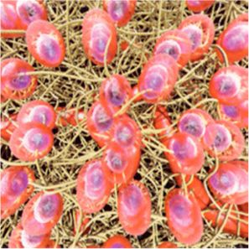






Does Regenerative Medicine Have a Presence in the Present?
>35,000 original papers & reviews
>50 companies with products in clinical development
Biomaterials
Cells
Cells + Biomaterials
>5,000 FTEs worldwide
> 250 training institutions worldwide
> $1B in total revenue (2008)*
Products are reaching the market
Autologous chondrocytes for articular cartilage repair
Dermal patches / engineered skin for wound healing
Fibrin sealants and patches
Collagen matrix for surgical repair
Trade Organizations are growing
Carticel®
OASIS®
Wound Matrix
Dermagraft®
*www.masshightech.com (8/18/2008)

Slide 6
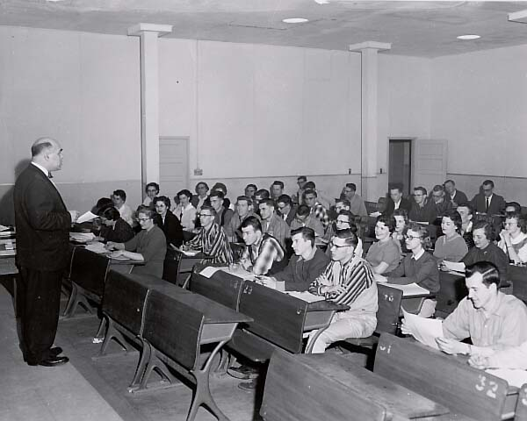
What Have we Learned?
“The first products…just did not behave as originally intended once they entered the clinic.”
“…the challenges of commercial-scale manufacture were considerable.”
“…[the] biotechnology business model centered on out-licensing or partnering through joint ventures…proved wholly inappropriate…”
“…the capital value of publicly traded tissue engineering corporations dropped by almost 90%, from US$2.5 billion at the end of 2000 to $300 million by the end of 2002.”
Kempo P. History of Regenerative Medicine:
Looking backwards to move forwards. Regen Med 1(5): 653-659, 2006

Slide 7

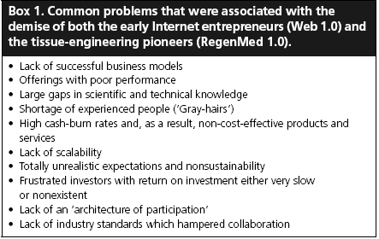
What else Have we Learned?
“Regenerative Medicine…after a period trapped in the notorious chasm, is now just starting to climb out the other side into mainstream clinical practice…we are probably leaving the chasm by a totally different route to the one we predicted when we tumbled in.”
Mason C. Regenerative medicine 2.0. Regen Med 2(1): 11-18, 2007

Slide 8

The Future is Challenging…Do we Give Up? Not a Chance!
“Change is the law of life. And those who look only to the past or present are certain to miss the future.” John F. Kennedy

Slide 9

Applying our Knowledge Forward To increase probability of success
Successful Clinical & Commercial Translation:
Constrain research with practical clinical and commercial limitations
Define development pathway in close collaboration with regulatory agencies
Strategic management of intellectual property
Purposeful filing of enabled product-relevant patents
Diligent management of know-how & trade secrets
Structure communication for public acceptance, medical understanding, and regulator / payer interactions
‘Do not [complicate products] beyond necessity’ (Occam’s Razor)
Scientific
Feasibility
Commercial
Viability

Slide 10
Tengion Product Pipeline
Optimization
Preclinical
IND
Phase I
Phase II
Phase III
Lead Programs in Development
Neo-Urinary Conduit
Cystectomy due to Bladder Cancer
Neo-Kidney Augment
Advanced CKD
Neo-GI Augment
Esophagectomy
Short Bowel Syndrome
Additional Platform Programs (not in active development)
Neo-Bladder Replacement
Cystectomy
Neo-Bladder Augment (1st gen)
Spina Bifida
Spinal Cord Injured
Urge Incontinence (laparascopic)
Neo-Vessel Replacement
Vascular Access Graft
Peripheral Artery Bypass
Coronary Artery Bypass
Notes:
Our product pipeline reflects the value of our platform.
We are advancing programs in 4 therapeutic areas.
Although your eye is drawn to our most advanced program, I’d like to draw your attention to our most valuable programs – the conduit for bladder cancer patients and the renal augment to delay the need for dialysis or transplantation.
In the urology franchise, after a phase 2 program for an ultra-orphan market was successfully completed, technology advances gave us the opportunity to go after a 20x larger market opportunity in bladder cancer patients.
Now, let’s focus on the urology franchise.

Slide 11

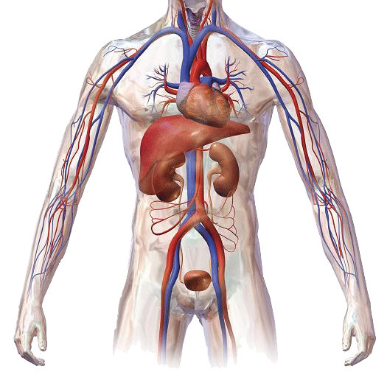
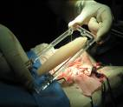
Iterative Combinatorial Approach to Regeneration Deriving the simplest effective solution
Biomaterials
Regenerative Template
Delivery
Cells
Bioprocess
INPUTS
Raw Materials
PRODUCT PROTOTYPE
Combination Products
Stimulate Regeneration
Integrate into Host
REGENERATED
OUTCOME

Slide 12
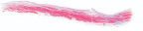
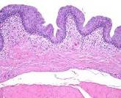
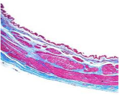
Application-specific Technology Evolution for translation of regenerative medicine products
Neo-Bladder Augment
Lancet 2006 367:1241
Bladder-derived
Urothelial cells
Smooth Muscle Cells
Bladder-derived
Smooth Muscle Cells
Adipose-derived
Smooth Muscle Cells
SMC-only Bladder
Bertram et al.,
Experimental Biology 2009
Neo-Urinary Conduit
Jain et al.,
TERMIS 2010
Iteration driven by operational & clinical necessity
Notes:
All requested preclinical studies are completed and submitted to FDA.
In 66 pigs, each up to 250 pounds…large animal data…
Native like regeneration in 3 months with no immune response
Looking inside the conduit, normal lining from ureters to skin
No urine absorption
No mucus secretion
At the junction with the skin, we actually see regeneration of infection fighting cells that should normally be present in any orifice from the body
Seen by experts as a hallmark of true regeneration
It worked.

Slide 13
A Future View for Regenerative Medicine Steady progress, product evolution, long-term vision
2010
2015
2025
Targets
- Cell Replacement or Structural Repair
- Functional Tissue/Organ Replacement
- Total Organ Replacement
Compatibility
- One “Size” fits all
- Multiple “Size” options
- Personalized Medicine
Availability
- Delayed Delivery
- Rapid Delivery
- Point-of-Care Delivery
Composition
- Assembled combination products
- More defined / integrative products
- Inductive biologics
Regenerated
Outcome

Slide 14

The View from BIO
Peter M. Pellerito
Interim Vice President for State Government Relations and Alliance Development, Biotechnology Industry Organization

Slide 15
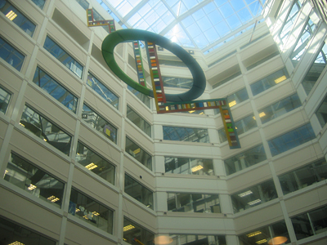
NSF Funding Opportunities
V. Celeste Carter
Division of Undergraduate Education
National Science Foundation
vccarter@nsf.gov
June 26, 2011

Slide 16
What is NSF currently doing for Community Colleges?

Slide 17
Active NSF 2-Yr College Projects
NSF Directorate | Active Awards | Total Funding
Education and Human Resources (EHR) | 371 | $301,511,331
Office of the Director (OD) | 5 | $24,615,888
Math and Physical Sciences (MPS) | 5 | $4,020,727
Geosciences (GEO) | 9 | $3,313,904
Biological Sciences (BIO) | 4 | $2,321,128
Computer & Information Science & Engineering (CISE) | 3 | $1,406,021
Social, Behavioral & Economic Sciences (SBE) | 3 | $434,884
Engineering (ENG) | 2 | $299,662

Slide 18
Active NSF 2-Yr College Projects

Slide 19
Active NSF 2-Yr College Projects (DUE)

Slide 20
Advanced Technological Education (ATE)
The ATE program has supported close to 1000 projects and centers since its inception in 1994.
From 1994 to 2010, the ATE program has provided $654,700,000 in support of community college technician education programs.

Slide 21
NSF Focus on Community Colleges
Building American Skills by Strengthening Community Colleges
President Obama set two national goals: by 2020, America will once again have the highest proportion of college graduates in the world, and community colleges will produce an additional 5 million graduates.
Role of Community Colleges in Undergraduate Education
Community colleges serve ~44% of the undergraduate students in the United States.
Half of the students who receive a baccalaureate degree attend community college in the course of their undergraduate studies. http://www.aacc.nche.edu/AboutCC/Trends/Pages/studentsatcommunitycolleges.aspx

Slide 22
Take Home
NSF is serious about supporting STEM projects at or involving Community Colleges
Dr. Subra Suresh, NSF Director
upon meeting DUE Program Officers asked “Do you (DUE) support community colleges?”

Slide 23
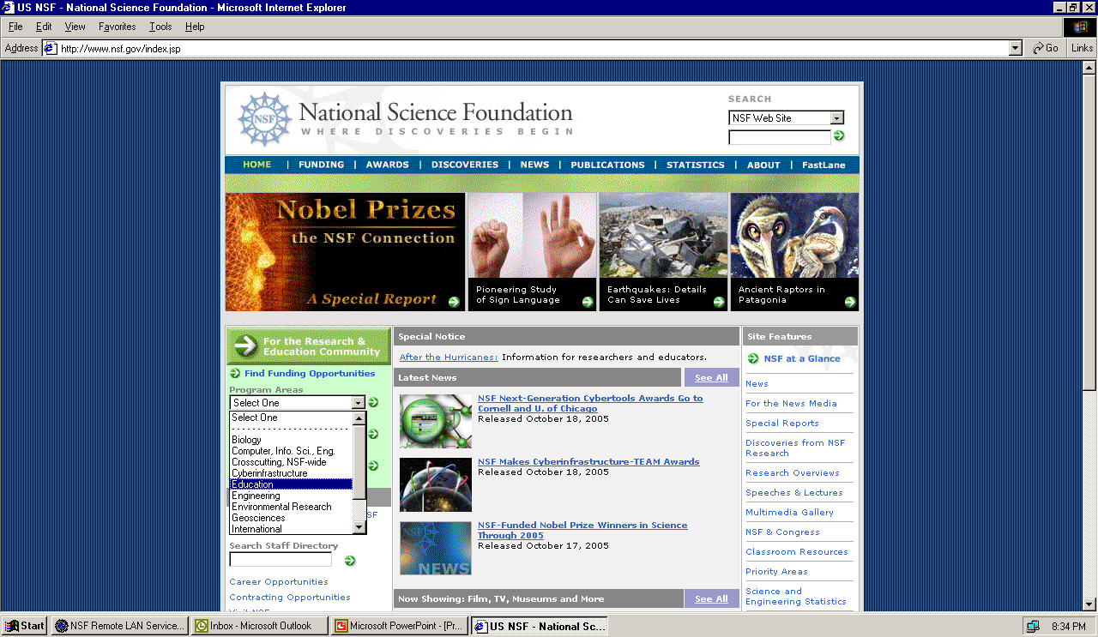
NSF web site (www.nsf.gov)

Slide 24
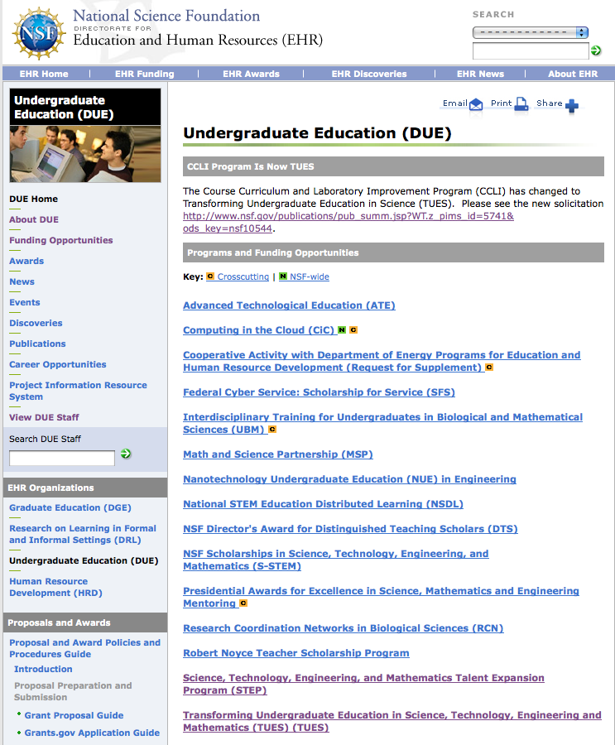
Division of Undergraduate Education (DUE)

Slide 25
Selected Programs in DUE
FY2009 FY2010 FY2011
(Requested)
ATE $52 $64 $64
TUES/CCLI $66 $39 $61
STEP $29 $31 $30
S-STEM $75-100 /year from H1B visa fees
NOYCE $115 $55 $55
MSP $86 $58 $58
*(in Million)

Slide 26
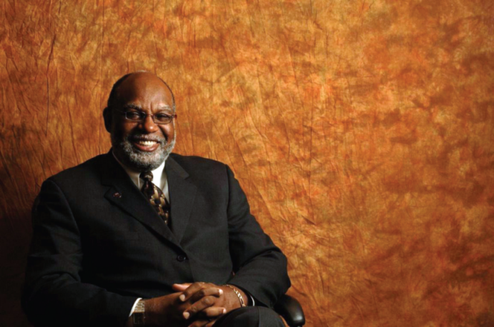
Advanced Technological Education (ATE)
Authorized under the Science and Advanced Technology Act of 1992 (SATA) and reauthorized under the America Competes Act.
Program focuses on the education of a quality STEM technical workforce for high-technology fields that drive the nation’s economy.
Grades 7-12, 2yr- and 4-yr institutions can be supported.
Community colleges have leadership roles on all projects.
“THE ATE PROGRAM SERVES AS A TRUE CATALYST FOR STUDENT SUCCESS AND ECONOMIC DEVELOPMENT.” RUFUS GLASPER, Ph.D., Chancellor Maricopa CCS
For more than a decade ATE centers and projects have been busy figuring out:
• How to recruit teens and adults—particularly underrepresented populations—for STEM careers
• What helps students succeed in STEM courses essential to a wide range of technical fields
• Where curricula should change to develop a world-class technical workforce.

Slide 27
ATE Program Tracks
Projects which focus on:
Program Development, Implementation and Improvement;
Professional Development for Educators;
Curriculum and Educational Materials Development;
Teacher Preparation;
Small Grants for Institutions New to the ATE Program;
Business and Entrepreneurial skills for students in technician education programs;
Leadership Capacity Building for faculty.
Mentoring students: recruitment, retention, completion
Centers of Excellence: National, Regional, Resource
Targeted Research on Technician Education

Slide 28
ATE
Resources
ATE Centers: http://www.atecenters.org
Evalua|t|e Center: http://www.evalu-ate.org
ATE Central: http://atecentral.net/
SCATE Center: www.teachingtechnicians.org
ATE PI Guide: http://govpiguide.org/
“Educating Biotechnicians”: http://www.aacc.nche.edu/Resources/aaccprograms/ate/Documents/biotech_report.pdf
“Preparing Energy Technicians for the 21st Century Workforce”:
http://www.ateec.org/store/catalog/Energy-General---Preparing-Energy-Technicians-for-the-21st-Century-Workforce-400.html

Slide 29
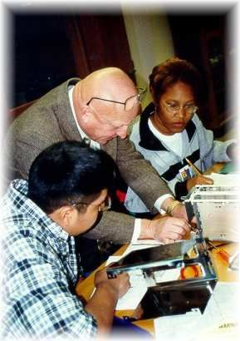
Education and Industry
Partnerships
Internships
Industry input driving curriculum
Hire adjunct faculty from industry
Skill standards
Industry Advisory Board
Career pathways
Economic Development/WIB involvement (both state and local)

Slide 30
Small Grants for Institutions New to ATE
Purpose
Simulates implementation, adaptation, and innovation in all areas supported by ATE.
Available only to community college campuses that have not an an ATE award within the last 10 years
Broaden the base of participation of community colleges in ATE.
Strengthen the role of community colleges in meeting needs of business and industry
Proposers are encouraged to include resources of ATE and other NSF awardees and to include those people as consultants and subawardees.
Limited to $200,000 with a maximum of 10% indirect (may change)
Funding rate for FY10 was between 70-80% for this area

Slide 31
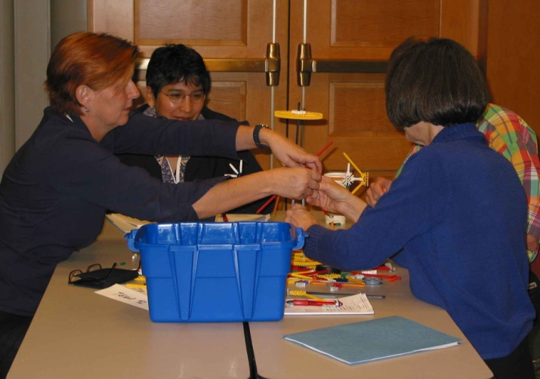
ATE
ATE solicitation (11-692):
www.nsf.gov , Education, DUE
Formal Proposals: October 20, 2011
$64 million request FY2011, same for FY2012
Projects: up to $900,000 for 3-yrs
Small, new to ATE: $200,000 for 3-yrs
Centers: $1.6 – 5 million for 4-yrs
Targeted Research: up to $1.2 million for 4-yrs

Slide 32

STEM Talent Expansion Program (STEP)
Goal:
to increase the number of students (U.S. citizens or permanent residents) RECEIVING associate or baccalaureate degrees in established or emerging fields within science, technology, engineering, and mathematics (STEM)

Slide 33
STEP Tracks
Type 1: Implement strategies that will increase the number of students obtaining STEM degrees.
Type 2: Conduct research on factors affecting associate or baccalaureate degree attainment in STEM

Slide 34

NSF Scholarships in Science, Technology, Engineering, and Mathematics (S-STEM)
Goal: institutions receive funds to provide scholarships to academically talented, but financially needy, students. Students can be pursuing associate, baccalaureate, or graduate degrees.
http://www.nsf.gov/pubs/2006/nsf06527/nsf06527.htm
H1B Visa Funds

Slide 35
Noyce Program
Initiated by Act of Congress in 2002
To encourage talented mathematics, science, and engineering undergraduates to pursue teaching careers
To encourage STEM professionals to become teachers
To prepare Master Teachers
FOR COMMUNITY COLLEGES
Internships for freshmen and sophomores
Career Changers: Stipends for STEM professionals seeking to become K12 teachers

Slide 36
Math and Science Teachers Project: Teachers of Excellence Program
Lake City Community College PI: Tracy Hickman
Alternative certification program for STEM professionals in rural North Central Florida
Practical experience with lesson planning, classroom management, and research-based cooperative learning strategies
Integration of real world math and science into classroom
Cohort development, mentoring, and follow-up supervision

Slide 37
Transforming Undergraduate Education in STEM (TUES) formerly CCLI
Vision
Excellent STEM education for all undergraduate students.
Goal
Stimulate, disseminate, and institutionalize transformative or innovative developments in STEM education through the production of knowledge and the improvement of practice.
*Most comprehensive program in DUE

Slide 38
TUES
Type 1 – Exploratory Projects
Involve exploratory, initial investigation or adaptation in one of the component areas. Deadline May 2011
Type 2 – Expansion Projects
Build on smaller scale but proven innovations, refine and test innovations on diverse users
Type 3 – Comprehensive Projects
Several diverse institutions, evaluation or assessment activities–deep & broad, combine proven results and mature innovations from several component areas, sustainability, national dissemination, etc.
Central Resource Centers – Talk with a Lead PI (Myles Boylin, Terry Woodin, or Don Millard)
Type 2 and 3 deadline in January 2012

Slide 39
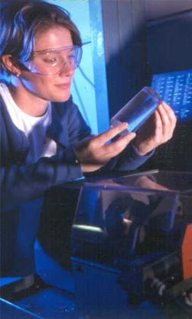
Other Programs in EHR
DRL
ITEST Innovative Technology Experiences for Students and Teachers Program
DRK-12 Discovery Research K-12
ATE
HRD
HBCU-UP
TC-UP

Slide 40
Writing a Proposal: Getting Started
Start EARLY
Get acquainted with FASTLANE
Read the Program Solicitation and follow the guidelines. Read the Grant Proposal Guide (GPG).
Learn about the recent DUE awards using the NSF Award Search tool
Become an NSF reviewer
Contact (e-mail is best) a program officer to discuss your idea. This may cause you to refine your idea and may prevent you from applying to the wrong program
Program Officers in DUE: Check the solicitations for names and contact information

Slide 41
Compliance Check
Pre-Compliance Check: Read the solicitation
Hurdle #1:
Do you specifically address intellectual merit and broader impacts in the project summary
Number of pages, formatting, font size
Completeness

Slide 42
Merit Review
Hurdle #2 (Mail and Panel Reviews)
Convince a panel of your peers that:
There is an identified need (describe what else has been done around this need)
You describe a good idea to solve the need
You and your team are the appropriate people to do it (you have the necessary expertise)
Your institution has the necessary infrastructure
Your goals and objectives are tied to evaluative activities (you will know if you are successful)
You have a plan to spread the results of your project

Slide 43
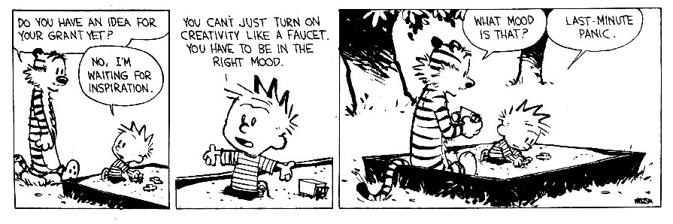
In Conclusion: Apply or You Will Never Receive an Award
Read the solicitation!
Read the GPG!
Read the solicitation!
Read the GPG!
THANK YOU!

Slide 44

15 Minute Break
Refreshments sponsored by:

Slide 45
Evolving Biotech Programs
Russ Read
Executive Director - National Center for the Biotechnology Workforce
Lisa Seidman Ph.D.
Co PI – Bio-Link

Slide 46



An Update on the NCBW: Creating a Path Toward NAM Endorsed Credentials
Russ H. Read
Community College Program at BIO 2011

Slide 47
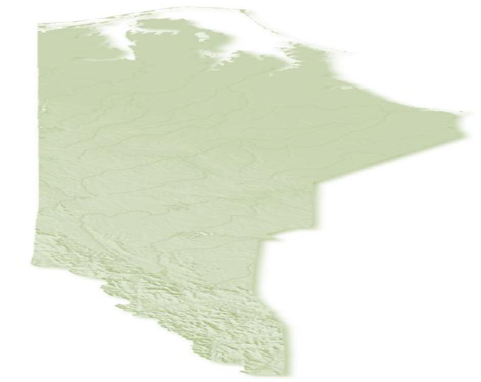
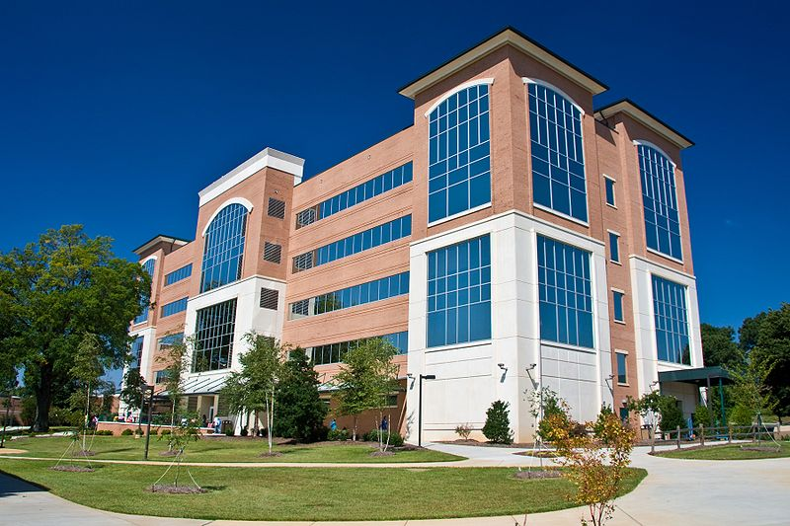
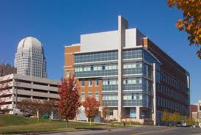
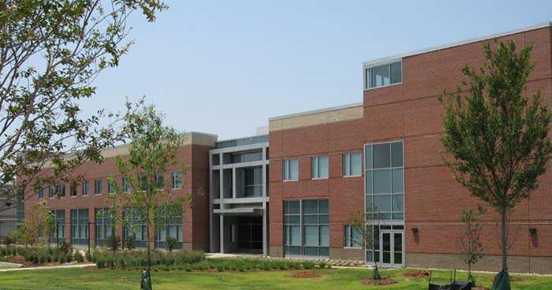
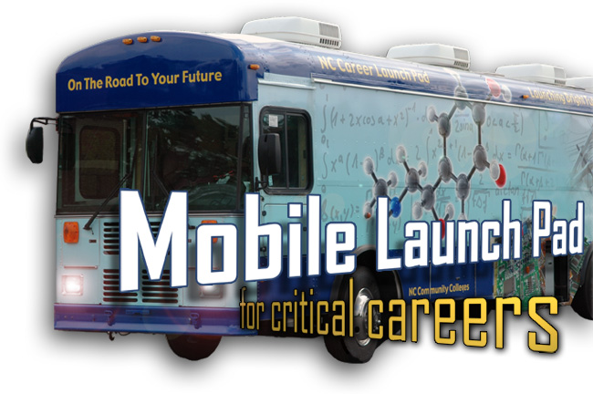
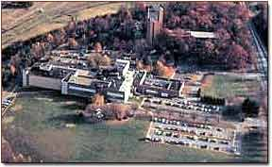
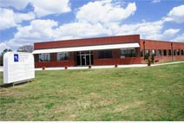
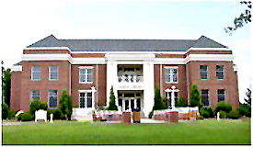
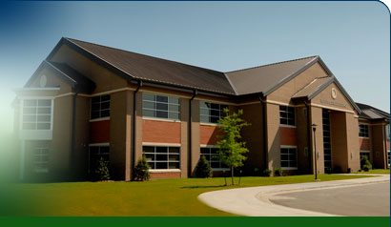
Pharmaceutical Center
& Analytical Training Lab
Winston-Salem
Capstone Center
Raleigh
Bioprocessing Center
Greenville
BioBusiness Center
Asheville
BioEducation Center
Gaston/Charlotte
BioAgriculture Center
Lumberton
www.ncbionetwork.org

Slide 48
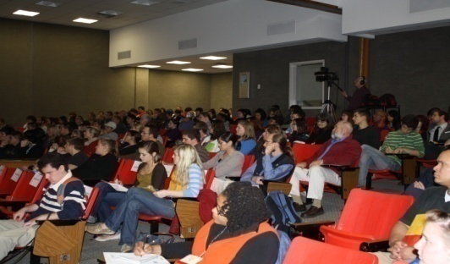
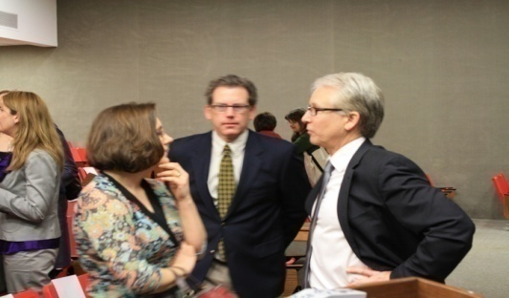
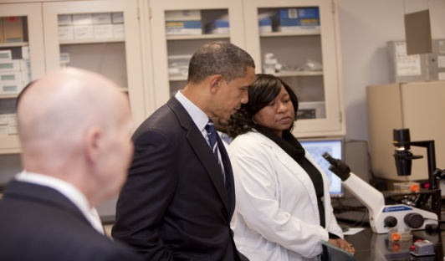
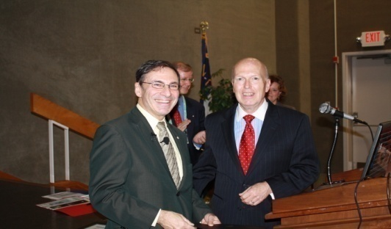
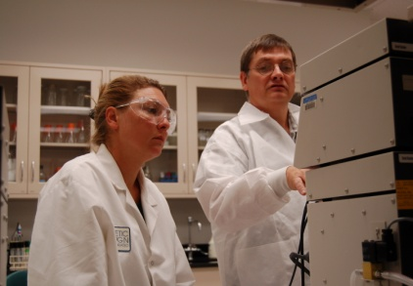
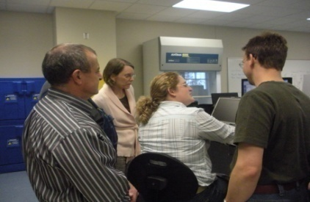


Why Presidents Visit FT
Biotech-an Example
Large Biotechnology program in NC
Site of a most advanced training and education network
-Pharmaceutical Center & Analytical Training Lab
-Nationally recognized workforce program
Outcome driven program-graduates are monitored
Finalist

Slide 49
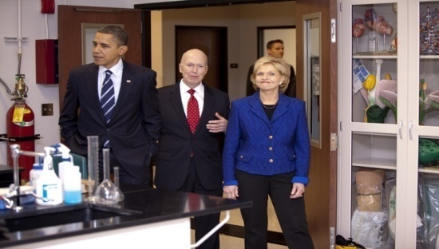
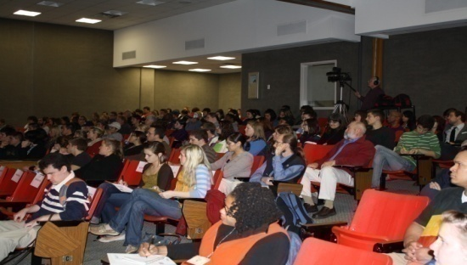
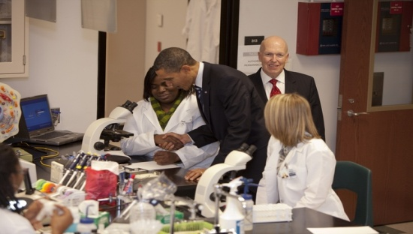
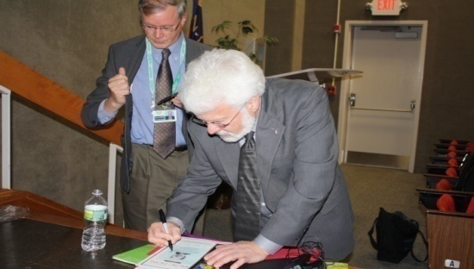
Priorities
2010-11
Advocacy:
Represent, enable and provide leadership at the national level for the biotechnology workforce with compatible organizations, educational and training institutions *
Enabler:
Support NC Community College’s BioNetwork & FT, NC and the Piedmont Triad Biosciences community
Implement the NCBW/BioNetwork Communications strategy
Work with the Manufacturing Institute to build a repository of NAM endorsed credentials in biotechnology and life sciences
* Biotechnology International Organization, the NSF-ATE, Bio-Link, NBC2, US DOL-ETA Bioscience Initiative and the Biotechnology Institute, NAM/MI, NC Biotech Center, NC Biosciences.

Slide 50







Organization | 1st Quarter | 2nd Quarter | 3rd Quarter | 4th Quarter
Bi-Monthly Bioscience Teleconferences - Advise on Best Practices & Grants
Participate in White Paper Meetings
Partner & Member of the National Visitors Committee
Pursue Mutual Goals & Seek Out National Certifications
Liaise with DC Office. Lobby & Help Organize Community College Program for June BIO mtg.
Advisor to the National Graduate Tracking Study
Partner & Advisor to NBC 2
Directors Meetings, Lobbying & Emerging Companies Committee
Chair P.T. Biotech Advisory Committee

Slide 51
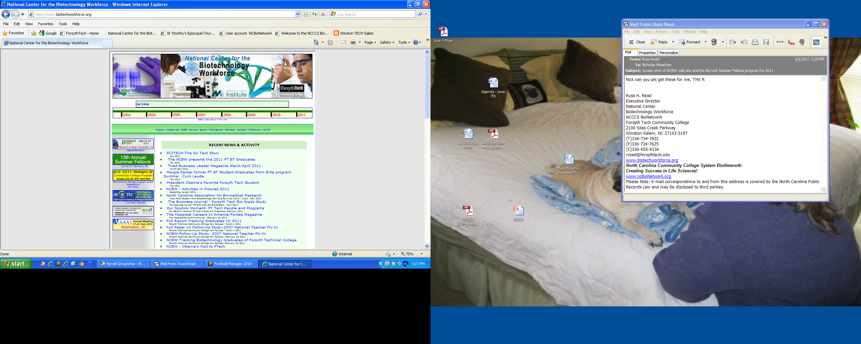
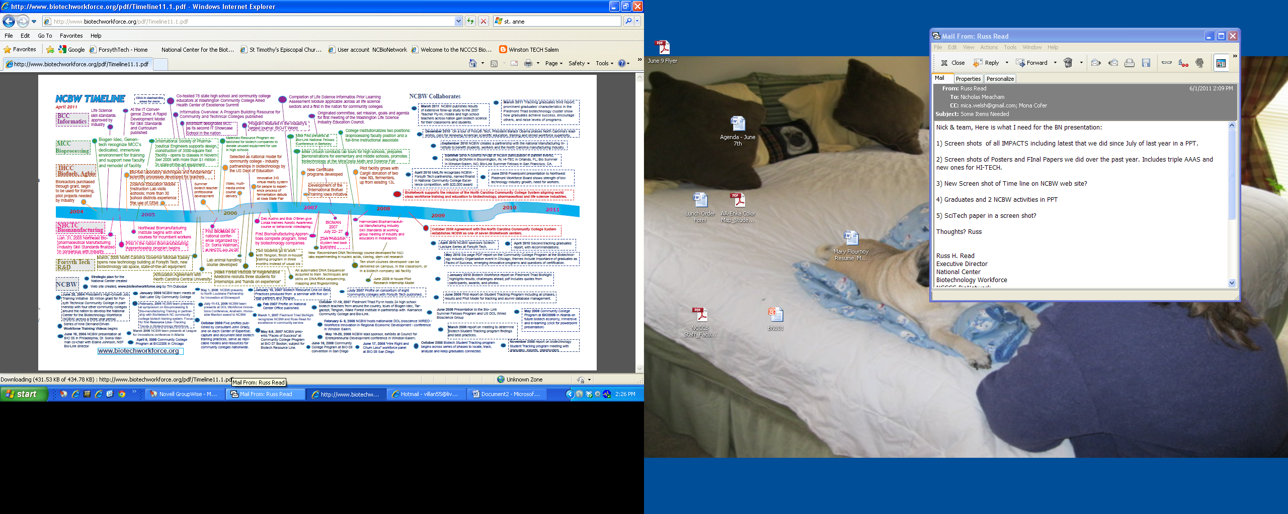
Web Driven INTERACTIVE TIMELINE 2004-2011
Just “click on it” to get the source document
www.biotechworkforce.org

Slide 52
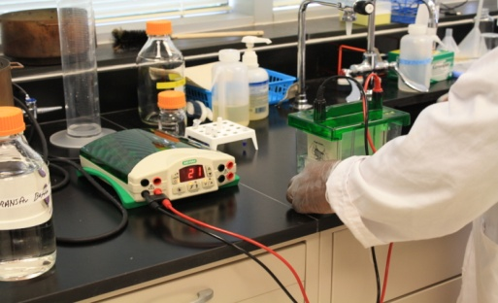
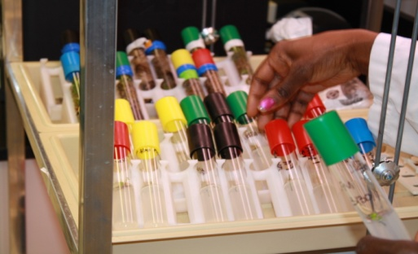
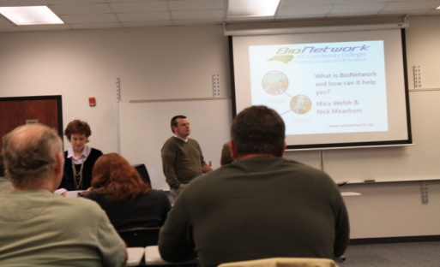
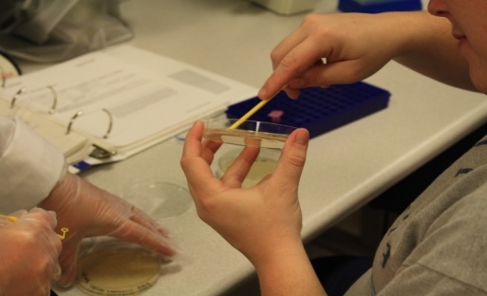
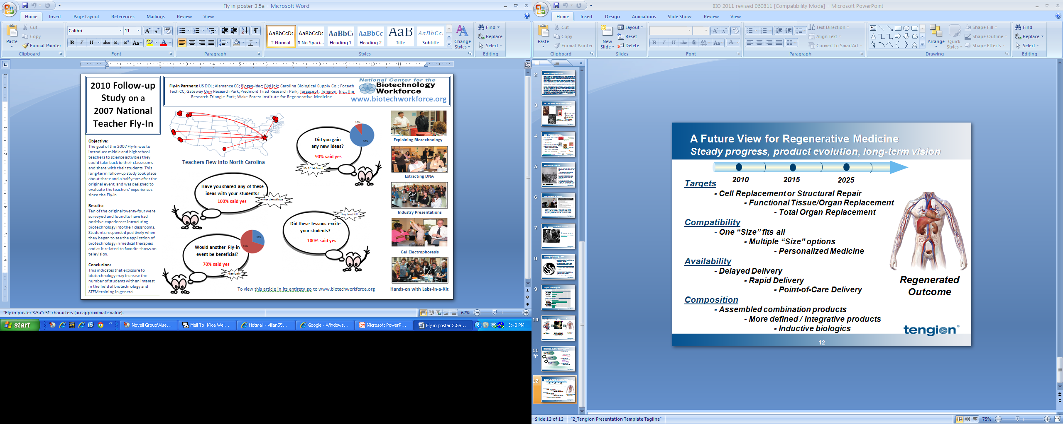
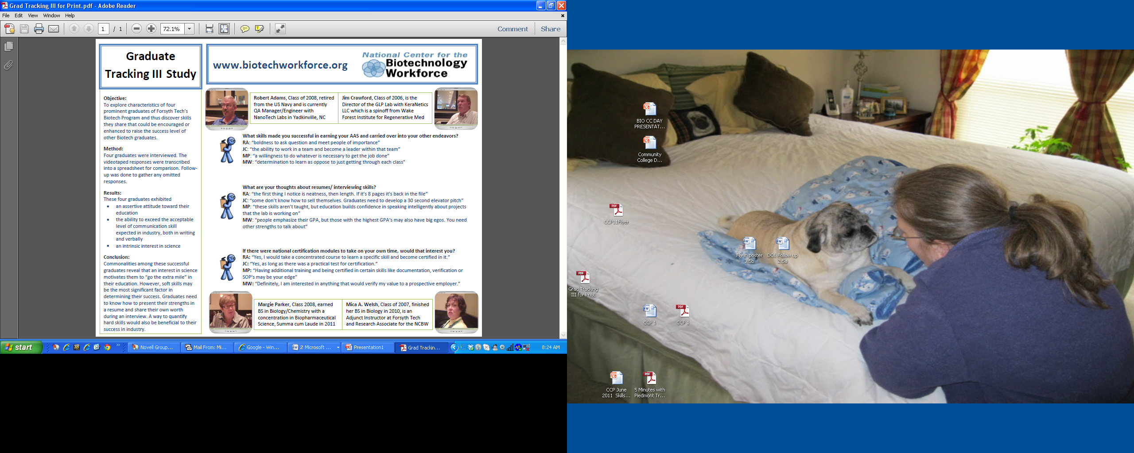
Partners/Collaborations
Interests
Partnerships-mutual grant(study)opportunities
Effectiveness & collaborative research

Slide 53
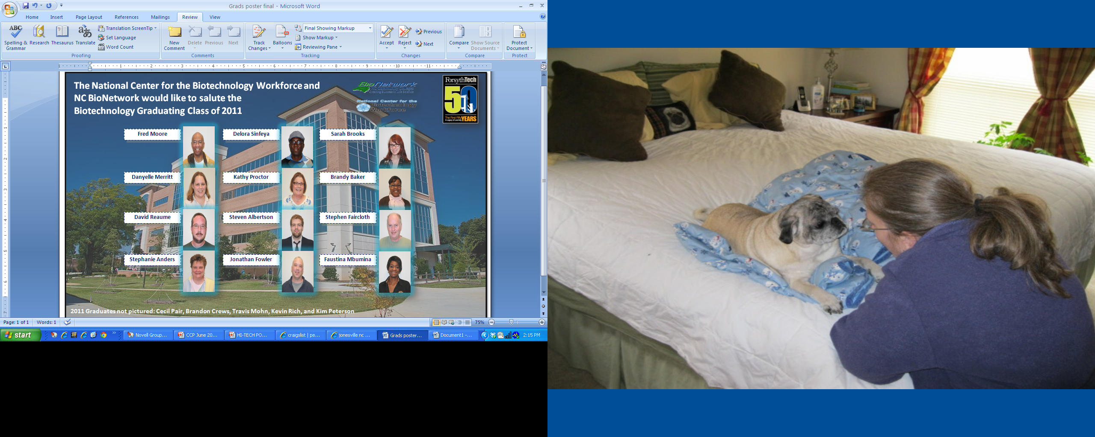

WE TRACK GRADUATES!

Slide 54

Providing competency-based, customized education and training for the manufacturing workforce…today and tomorrow
Notes:
On March 4, 2009, we launched the cornerstone of our answer—the NAM-Endorsed Manufacturing Skills Certification System.
By deploying this system of industry-recognized skills certifications through our educational and workforce development systems, we can produce the high performance workforce that is critical to the strength and vitality of our manufacturing economy.
Our purpose in developing and deploying this system of skills certifications is to provide industry’s voice and expertise in helping this nation provide competency-based, customized education and training for the manufacturing workforce.

Slide 55

Charlotte Business Journal
Date: Wednesday, June 22, 2011, 2:42pm EDT
“North Carolina’s transition from traditional manufacturing, like textile and apparel, to high-tech manufacturing, biotechnology and services, is a necessary transition,” says TD economist Christos Shiamptanis, who authored the report.
“High-skilled jobs are less sensitive to economic contractions than middle-skilled jobs, and the creation of high-tech business clusters is enhancing efficiency, improving productivity and bolstering the state’s output.”

Slide 56
USA Manufacturing Jobs Require Higher Skills
Notes:
Today’s manufacturing jobs require higher skills competencies. As shown in the chart, high-skilled jobs in the manufacturing sector grew by 12 percent from 2003 through 2010 while mid-skilled jobs decreased by 3 percent and low-skilled jobs fell 9 percent over the same period. This trend toward a more skilled workforce is important according to a recent survey of U.S. executives: “A skilled, educated work force is the single most critical element of innovation success—and the hardest to acquire.”

Slide 57

Hagan introduces manufacturing jobs bill
The Business Journal - by Matt Evans
Date: Wednesday, June 22, 2011, 1:47pm EDT
Sen. Kay Hagan is introducing a jobs bill in Congress she says will "create a common sense system" to connect out-of-work people with jobs.
The bill would expand on an idea that Triad community colleges have been at the forefront of for the past two years, creating a nationwide credentials for industries ranging from machinery manufacturing to biotechnology.
The "America Works Act" would create incentives for industries to establish national credentialing systems that would qualify workers for jobs in that industry in any state in the country.

Slide 58
The NAM-Endorsed Manufacturing Skills Certification System
Aligned to the Manufacturing Competency Model
Nationally Portable
Third-Party Validated (ISO/ANSI Preferred)
Industry-Driven
Data Based and Supported
Career Pathways, Life-Long Learning(Education Pathway) and Credentials(Certification Pathway)
Notes:
To increase speed to market, the Institute evaluated over 450 certificates and certifications focusing first on credentials that are
Nationally portable;
Third-party validated; and
Industry driven.
The Manufacturing Institute worked with key certification partners who are the world market leaders in skills certification programs that align with these four tiers of skill requirements.
This collaborative effort resulted in an organization of the certification programs, and the credentials they offer, into a system of “stackable credentials” that can be awarded in secondary and post-secondary education.

Slide 59
Advanced Manufacturing Competency Model Elements
High Quality Middle Class Jobs
Occupation-Specific Certifications
Career Paths – Life Long Learning
Entry Level Industry Certifications
Ready for Work, Ready for College
Notes:
The evolution to the Skills Certification System began with a 2-year development of the Advanced Manufacturing Competency Model, announced in May 2006.
This model, built by manufacturers, for manufacturers, is essentially a roadmap of the skills needed by workers entering and then advancing in careers across the manufacturing economy.
Our first focus has been on the core or basic skills that cut across all sectors in manufacturing.
These core or basic skills are:
Personal Effectiveness Skills – for example, will prospective employees show up on time, ready for work
Basic Academic Requirements – for example, will prospective employees have the basic math and reading skills needed
General Workplace Competencies – for example, can the prospective employees work in teams
Industry-wide Technical Competencies – for example, will prospective employees understand the basics of manufacturing

Slide 60
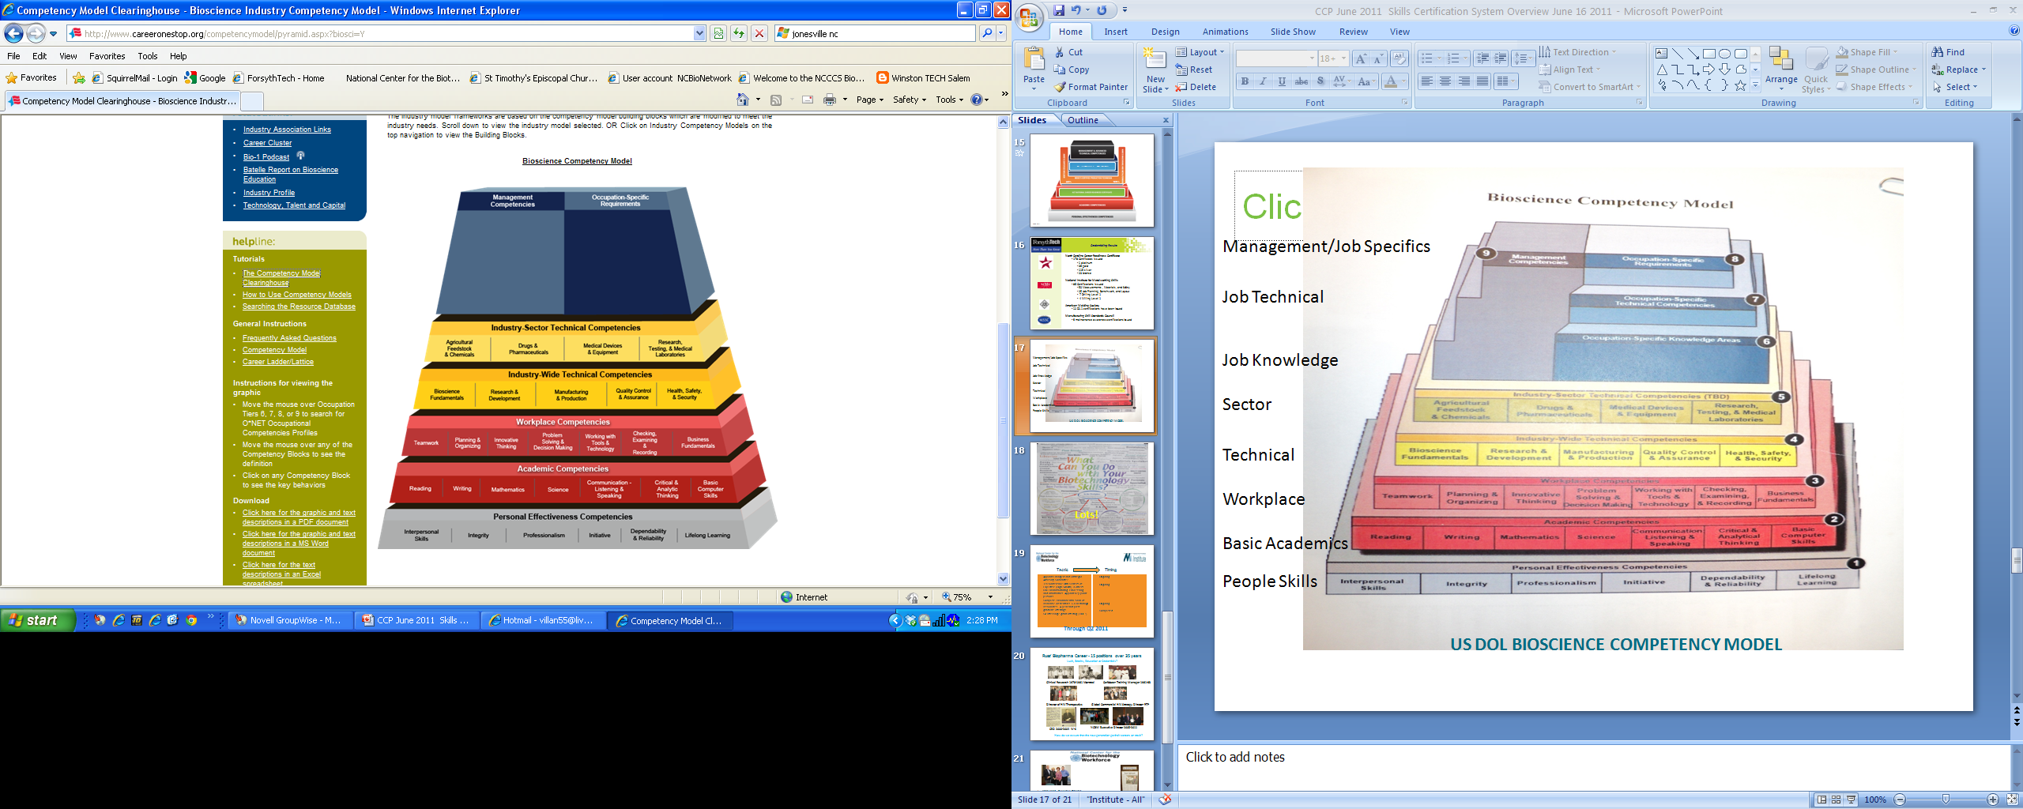
Management/Job Specific
Job Technical
Job Knowledge
Sector
Technical
Workplace
Basic Academics
People Skills
US DOL BIOSCIENCE COMPETENCY MODEL
http://www.careeronestop.org/competencymodel/pyramid.aspx?BIOSCI=Y&ES=Y&EST=bioscience+model

Slide 61

Notes:
61
The Skills Certification System, and the career pathways in manufacturing that it supports, also align to education pathways in secondary and postsecondary education. Integrating the skills certifications into those education pathways implies that they should become part of degree programs of study, so that a worker can progressively pursue stackable credentials and “bank” credits, engaging in a lifetime of learning.
This upwardly mobile ladder directly demonstrates how learning is a continuum throughout a worker’s life as more competencies are acquired and documented with a recognized credential. Credentials gained through the Skills Certification System will strengthen an individual’s ability to be mobile in the workforce, compete for higher-level jobs, and move to in-demand careers by:
Providing skills and competencies recognized industry-wide; and
Providing career pathways clearly mapped to educational pathways tied to credentials preferred by employers in multiple sectors.
This system gives each individual a path to succeed, the skills to compete, and the opportunity to win.

Slide 62





Credentialing Results
North Carolina Career Readiness Certificate
178 Certificates issued
1 platinum
39 gold
115 silver
23 bronze
National Institute for Metalworking Skills
86 Certifications issued
50 Measurements , Materials, and Safety
25 Job Planning, Benchwork, and Layout
7 Drilling Level 1
4 Milling Level 1
American Welding Society
12 D1.1 certifications have been issued
Manufacturing Skill Standards Council
9 maintenance awareness certifications issued

Slide 63


Talent Acquisition Strategy In BioPharma
“Particularly when the employment market is flooded with talent – either due to economic-driven layoffs or those associated with mergers and acquisitions – employers generally become more discerning with the identification of successful candidates for open or vacant positions. Assuming everything else is equal (years of relevant industry experience, academic credentials, general minimum requirements), those individuals with specialized certifications are likely to get the nod over those applicants without them.
Certified Quality Auditor (CQA), Certified Public Accountants (CPA), Certified Clinical Research Associate (CCRA), Diplomate of the American Board of Toxicology (DABT), Regulatory Affairs Certification (RAC), and Certified Health Physicist (CHP) are symbolic of just a few biopharmaceutical certifications in demand.
Targacept just recently added to its talent line-up an EH&S-Environmental, Health & Safety Manager.
The individual hired for the position not only possessed a Master’s in Public Health with concentration in Occupational Health, but also has credentials as a CIH (Certified Industrial Hygienist) and CSP (Certified Safety Professional) – two is better than one.
Achievement of such nationally recognized certification credentials signals to employers that the individual has endeavored to add knowledge, skills, and competencies to his or her area of expertise with rigorous areas of intense study and testing.
These certifications are extremely important for small-to-medium biotech companies who generally tend to staff on a fairly lean basis.
Having a workforce with depth, breadth, and specialty of the incumbents’ respective career professions helps to ensure the company’s projected growth curve is on target for sustainable success.”
Karen A. Hicks
Vice President, Human Resources
Targacept, Inc.

Slide 64

Lots!

Slide 65
Biotech
Tactic
Timing
Appoint Enlarged and Strategic Advisory Committee
Teleconference with Centers of Expertise (High Growth) & others, R&D, Manufacturing, Processing and Informatics- Appoint key point persons
Complete environmental scan of available credentials- STEM through associates, 4 year and post graduate offerings
Go after large grant offering (DOL)
Ongoing
Ongoing
Ongoing
Completed
Through Q2 2011

Slide 66





AAS ‘11 3.0 GPA
Russ Read, Executive Director
Mona Cofer, Administrative Assistant
Mica Welsh, Research Associate
Nick Meacham, Communications Coordinator
Mary Flournoy, Federal Work Study Student
Margie Parker, AAS,BS Summa Cum Laude
2011
THANK YOU!
www.biotechworkforce.org

Slide 67


PREPARING STUDENTS FOR NEW OPPORTUNITIES IN STEM CELL TECHNOLOGIES
Tori Barron
Lisa Seidman
Madison Area Technical College
Community College Program at BIO 2011

Slide 68
OVERVIEW
Rationale; why this program?
Programmatic issues
Curriculum

Slide 69







RATIONALE
Meeting needs of students
Meeting needs of local employers

Slide 70
PROGAMMATIC
Resources
Expertise
Equipment
Space
Students
Curriculum and instructional materials
Institutional support, grant support, community support

Slide 71
Human Embryonic Stem Cell Culture Methods Curriculum Development
hESC educational curriculum (4 credit course)
M,W,TR (6:30-9:15pm)
Needs of local industry and research communities
Strong aseptic technique
Stem cell culture experience
Understanding of stem cell morphology, culture systems, and characterization techniques

Slide 72
Curriculum Development Core Stem Cell Culture Skills
Aseptic Technique
No antibiotics
Media and Matrix Preparation
Challenging laboratory math
Students thaw own frozen cultures post-break
Live cells to start, freezing prior to break
Freezing and Thawing
When and how to passage
Passaging and Maintenance
Contaminationprevention
Two distinct culture systems
Sequence and timing
Negative selection to remove differentiation
Photographic microscopy
Notes:
Challenging laboratory math, Separate aliquots for each student
Students learn two culture systems most common in industry and research
Sequencing of preparation and timing are key
Passaging and maintenance of hESCs
Understanding when to split cells and at what density
Photographic microscopy to assess confluency, morphology and differentiation
Picking hood to remove differentiation
Freezing and Thawing of hESCs
Live cells to start, then freezing prior to holiday
Students thaw own frozen cultures post-breakUnderstanding when to split cells and at what density
Photographic microscopy to assess confluency, morphology and differentiation
Picking hood to remove differentiationUnderstanding when to split cells and at what density
Photographic microscopy to assess confluency, morphology and differentiation
Picking hood to remove differentiation

Slide 73
Curriculum Development Quality and Business
Molecular Characterization of hESCs
Karyotypic Analysis
Fluorescent Microscopy
Embryoid Body Formation
Immunocytochemistry
cGMP
Scale-up
Toxicity testing
Regenerative therapy
Standard Operating Procedures
Documentation
Final Product Testing
Drug testing
Justin Koshalek – Fall 2010

Slide 74

Curriculum Development Classroom Education
Dale Lange – Fall 2010
Reading and Lecture topics
Core
Intro to hES cells
Culture systems
hES cell signaling pathways
Supplemental
Induced pluripotent stem cells (iPS)/reprogramming
Regenerative medicine
Notes:
, metaphase harvest
DAPI Chromosomes, fluorescent microscopy
Scientific communication skills and reinforcement of course material through project

Slide 75

Future Curriculum Directed Differentiation and Advanced Topics
Differentiation of hESCs
Neurons
Cardiomyocytes
qPCR
Advanced Topics
Bioethics
Legislation
Cancer stem cells
Epigenetics
Zhang et al, 2001

Slide 76
Ohio Bioworkforce Training Partnership
Bill Tacon, Ph.D.
Senior Director, Workforce & Education
Community College Day, BIO, June 26, 2011

Slide 77
Bioscience is an Important Sector of Ohio’s Economy – and it’s GROWING

Slide 78
Ohio. More than you know…
7th largest state with 11.5 million people
Within 1 day drive of 61% of USA, 50% Canada
Highly educated workforce
> 150 colleges and universities
4th in the nation for biotech Industry strength

Slide 79

Bioscience employment in Ohio has grown 2% on average each year since 2000. Conversely, total employment in all sectors of Ohio has declined 1% on average each year.
2010 GR p.8

Slide 80


Bioscience in Ohio’s Six Regions
The bioscience industry is not confined to one or two areas of the state. It has become a vital economic engine in each region, with bioscience-related companies found in 72 of
88 Ohio counties.

Slide 81


In 2009, the total employment in Ohio’s bioscience sector was 62,533, a small decrease of 388 jobs since 2008. From 2000-2009, bioscience employment increased by 10,222 jobs (19.5%). The overall growth in the bioscience sector is especially promising given that overall Ohio employment decreased by 465,000 since 2000.

Slide 82
Economic Impact of Bioscience in Ohio
Employment Impact 195,835 jobs
Output Impact $61.642 billion
Value-added Impact $15.208 billion
Labor Income Impact $7.691 billion
Tax Revenues $3.242 billion
The economic impact of the bioscience sector and its five subsectors is measured for Ohio and each of the six geographical regions in terms of employment, output, value added, labor income, and taxes. Impact values above include direct, indirect and induced impacts.
2010 GR p.7

Slide 83

Ohio Bioscience Growth Report 2010
Footnotes in this presentation refer to page number where data on each slide appear in the GR

Slide 84
Our Workforce Approach
Growth most evident in bio-manufacturing
Companies moving to and expanding in Ohio
All have problems in recruiting a skilled workforce at all levels
Our emphasis has been to build a strong community college bioscience infrastructure to provide entry level development & manufacturing workforce
Other states have done similar with great success

Slide 85
Ohio Bioworkforce Training Partnership
3 year program, funded through US-DOL
Awarded $5 million
Started March 1, 2010
Objective is to train 700 unemployed, displaced and underemployed workers, and find them jobs within Ohio’s bioscience industry. Special emphasis on displaced autoworkers
Applicants can select from a range of training programs depending on interests and aptitude
More than half of the award, $2.8 million kept for tuition reimbursement / scholarships

Slide 86
Program Partners
BioOhio
Six Community College Partners
NE Ohio: Cuyahoga CC, Lakeland CC
NW Ohio: Owens State CC
Central Ohio: Columbus State CC
SW Ohio: Sinclair CC, Cincinnati State Technical & CC
Council for Adult & Experiential Learning (CAEL)
AFL-CIO / UAW
Ohio’s One Stop Centers
Ohio Department of Development
Regional Industry Advisory Boards

Slide 87
Programs Offered
2 year Degree Programs in:
Biotechnology (R&D/Manufacturing Tech)
Biomedical Equipment Technician
Biomanufacturing Certificate(s)
Pharmaceutical Manufacturing Certificate
Medical Device Manufacturing Certificate
Bioscience Lab Skills Certificate

Slide 88


Slide 89
Bill Tacon, Ph.D.
Senior Director, Workforce & Education
BioOhio
1275 Kinnear Road, Columbus, OH, 43212
614.675.3686 x1265
btacon@bioohio.com
www.bioohio.com

Slide 90
Eighth Annual Community College Program Day International BIO Conference June 26, 2011 Washington D.C.

Slide 91
Fulfilling the Perkins IV TSA Requirement in Missouri PORTFOLIOS
Eilene Lyons
Founding Biotechnology Program Coordinator
Acting Dean, STEM Division

Slide 92
St. Louis Community College – Florissant Valley
BIOTECHNOLOGY PROGRAM

Slide 93
First Biotechnology Program in Missouri
Started Fall 1999
R & D based program
AAS and Certificate of Specialization degrees

Slide 94

Coming soon: Bridge to Biotech
Bio-Link Summer Fellows Forum 2011
Synergy project dissemination: CCSF Bridge to Biotech

Slide 95
PORTFOLIO Technical Skills Attainment
Appropriate End-of-Program Assessment

Slide 96
Perkins IV
Emphasizes a Technical Skills Attainment (TSA)
Third-party
Aligned with industry-recognized standards
No standardized TSA assessment for biotech
“None Available”

Slide 97
Missouri Department of Education
Collaborated with MO CC’s to develop portfolio assessments in 2010
Customized TSA per your program
Eliminates “ None Available”

Slide 98
Missouri Department of Education
Portfolio TSA must reflect rigor of the CTE program
Demonstrate attainment of soft skills
Oral, written, electronic communication
Ability to read and follow procedures

Slide 99
Students are well prepared
Excellent laboratory notebooks
Presentations required in biotech classes
Resume preparation
Mock job interviews
Career and Placement e-Recruiting system

Slide 100
Missouri Portfolio TSA Requirements
Student facilitated portfolio review
Short presentation
Lab notebook review
Three industry evaluators
Questions on work presented and notebooks
Complete a defined rubric and score skills or competencies

Slide 101
Selection of Evaluators
Industry experts who know our program
Have hired our graduates
Understand these are sophomores, not graduate students
Briefed on rubric used for assessment

Slide 102
Scoring Guide for Portfolio Evaluation
SKILL or COMPETENCY | Performance Levels |  |  | Score
 | 10 | 5 | 0
 | Meets Expectations | Developing | Missing
1) Effective communica-tion about project(s) contained in lab notebooks presented to the panel (X3 = 30) | Clearly explains the project so that a scientific evaluator can understand it. | Somewhat explains the project so that a scientific evaluator can understand it. | Information lacking or not very well explained
2) Determines the correct personal protective equipment (PPE) required for a laboratory technique per MSDS | Correctly identifies PPE required for routine laboratory techniques performed in the program | Identifies some PPE required for routine laboratory techniques performed in the program | Cannot identify PPE required for routine laboratory techniques performed in the program
3) Follows recordkeeping per guidelines of the Biotech Program | Guidelines followed throughout scientific notebooks | Guidelines not consistently followed in scientific notebooks | Guidelines not followed in scientific notebooks
4) Evidence of ability to follow laboratory procedures | Lab notebook(s) include protocols and SOPs that can be explained | Lab notebooks include only some protocols and SOPs; some ability to explain them | No protocols or SOPs and inability to explain what was performed in laboratory exercises

Slide 103
5) Evidence of proper use of laboratory equipment used in lab exercises | Questions from panel and results of experiments clearly show proper use of equipment | Questioning or results of experiments somewhat show proper use of equipment | Questioning and results of experiments do not show proper use of equipment
6) Demonstrates the ability to use proper sterile technique as required | Correctly describes proper sterile technique for aseptic procedures performed per notebook | Partially describes proper sterile technique for aseptic procedures performed per notebook | Cannot correctly describe proper sterile technique for aseptic procedures performed per notebook
7) Demonstrates the ability to troubleshoot a problem in the lab | Describes a situation in which troubleshooting was required and explains how problem was resolved | Describes a situation in which troubleshooting was required but problem was not fully resolved | Unable to describes a situation in which troubleshooting was required or carried out
8) Demonstrates the ability to properly analyze results and formulate conclusions | Lab notebook(s) clearly show(s) cogent analysis and conclusion. | Lab notebook(s) inconsistently show(s) cogent analysis and conclusions. | Lab notebook(s) fail to clearly show cogent analysis and conclusions.
Total points required: ≥ 65%
(pass/ fail)

Slide 104





Advanced Topic Presentation
Forensics
Proteomics
qPCR
Plant Transformation
RNAi
Bioprocessing

Slide 105

Internship Presentation BIO-BENCH Contract Research Organization

Slide 106

2011 Results
TSA assessment for 6 graduates
All scored above 80%

Slide 107
Failure?
Individualized remediation and reassessment
Positive feedback and encouragement
Additional job placement guidance

Slide 108
Summary
Portfolio TSA approved for Perkins IV funding
Demonstrates
rigor of our biotech program
attainment of soft skills
attainment of technical skills
A customized TSA assessment for graduates of Biotechnology Programs

Slide 109
Thank you.
http://www.dese.mo.gov/divcareered/documents/TSA_Portfolio_Proposal_Memo_and_Rubric.pdf
http://www.dese.mo.gov/divcareered/perkins_iv_tsa.htm

Slide 110




Bio-Link ATE National Center for Biotechnology & Life Sciences
Expanding the Impact
Elaine Johnson, PI & Executive Director
www.bio-link.org

Slide 111
Mission:
increase the number and diversity of well-trained technicians in the workforce
meet the growing needs of industry for appropriately trained technicians
institutionalize community college educational practices that make high-quality education and training in the concepts, tools, skills, processes, regulatory structure, and ethics of biotechnology available to all students.

Slide 112
Invitation to share Bio-Link Goals:
strengthen and expand biotechnology education programs across the nation
enable biotechnology faculty, students, and technicians to work more efficiently
support a smoother transition of students to the technical workforce in the biosciences and related industries

Slide 113
Activities:
The Bio-Link Center of Excellence:
delivers direct services including consulting, professional development, maintenance and replication of an equipment depot, instructional clearinghouse, and faculty internships
shares information and promotes collaboration with web-based community through the use of Web 2.0 tools, conference presentations, and Synergy collaboratory
expands and improves information for students and life-sciences companies with national survey information, career matrix, and video career scenarios

Slide 114

Research, Practice and Transformation Through Synergy
Collaboratory
A Collaboration of ATE Centers for
Achieving Scale

Slide 115
AAAS Vision and Change
Strong interest & involvement in undergraduate biology education
Commitment to hands-on skills
Dedication to preparing workforce
Belief in access for all students
Engagement of partners
Interdisciplinary focus

Slide 116
Next Generation Bio-Link
Direct Services
Professional Development
Leader-Links
Project & Center Advice
Partnership Building
Clearinghouse
Equipment Distribution
Courses in a Box
Online Courses
Career Information
Faculty & Student Internships
Dissemination of Best Practices
Longitudinal Survey
Networking

Slide 117

Our volunteers are great!! Always willing to lend a helping hand!

Slide 118
Next Generation Bio-Link
Conferences Coming Up in 2011
HI-TEC, July 25 - 28, San Francisco, CA
League for Innovation, STEMtech,
October 2 – 5, Indianapolis, IN
ATE-PI, October 26 -28, Washington, DC

Slide 119
Next Generation Bio-Link
What is our impact?
What is the evidence?
ejohnson@biolink.ucsf.edu

Slide 120
Lunch Noon – 1:00pm

Slide 121


Faces of Success 2011
Community and Technical College Biotech Program
Graduates at Work
Greetings
Lori Lindburg, Director, BayBio Institute
Moderators
Elaine Johnson, Director, Bio-Link
Jo-Anne Hongo, Senior Scientific Manager, Genentech, Inc.
Notes:
121

Slide 122
Our Panelists
David Haddad, Millenium
Great Bay Community College
Angie Yee, Genentech
City College of San Francisco
Trisha Castillo, St. Edward’s Forensics Science Program
Austin Community College
Aziz Ahmad, Forsyth Technical Community College
Forsyth Technical Community College
Tori Barron, Life Technologies
Madison Technical Community College
Closing remarks - Lori Lindburg, Director, BayBio Institute
Notes:
122

Slide 123


David Haddad
Lab Assistant
Graduated From Great Bay Community College
Formerly NHCTC
Faces of Success
Bio Conference
Washington, D.C.
26Jun2011
© 2008 Millennium: The Takeda Oncology Company

Slide 124

Education
High School
Advanced Math and Chemistry
Took Microbiology through Project Running Start
Jobs at College
Tutor: Chemistry, Biology, and Biotech Research
Lab Aid: Chemistry
Internship
Worked over summer developing fake DNA fingerprinting kit using plasmids
Received Associates Degree in Biotechnology in 2007

Slide 125

Responsibilities in Lab Ops
Media Prep
Preparing Solutions
Stocking Shelves
Cell Culture Support
Stocking Labs
Working with vendors to get supplies
Assisting with research as time allows

Slide 126

Future Plans
Get my Bachelors degree at Harvard Extension School in 2013
Transfer to a research position in Millennium
Get a graduate degree

Slide 127

Giving Back
Giving Talks
Panel discussions, job fair, conferences
Lab Supply Donations
Acacia in Kenya, Great Bay, LHS, Lexington
Digits
Promoting STEM education

Slide 128



Angie Yee
Faces of Success 2011
Washington, DC
Notes:
128

Slide 129






My Journey
Notes:
129

Slide 130



My Current Position
Goal - to develop potentially therapeutic antibodies
Immunization
Immunization
➔
Fusion
➔
Fusion
Screening
➔
Clone Expansion
➔
Subclone Screening
➔
Purification
➔
Characterize
Notes:
130

Slide 131
Paying It Forward
Notes:
131

Slide 132
Questions?
yee.angie@gene.com
Notes:
132

Slide 133

Trisha Castillo
Austin Community College

Slide 134
Background Information
Parent at a Young Age
Got My GED
Counselor at ACC Led Me to the Biotech Program
Tough Program But One that Could Lead to A Career

Slide 135
Present Situation
Presently in my Senior year in St. Edward’s Forensics Science Program
http://www.stedwards.edu/academics/bachelors/forensicscience
Goal: A B.S. in Forensic Science

Slide 136
Dreams and Aspirations
A Job in a Forensic or a Drug Analysis Laboratory
Provide a Better Life for Myself and my Children

Slide 137
How Do You Give Back
Helped with the Installation of a New Lab
Helped with the Development of Protocols
Initiated the Development of a Articulation Agreement with St. Edward’s Forensic Science Program
Helping to Develop Laboratory Experiences for Biotechnology Students in the Area of Forensics

Slide 138

Aziz Ahmad, MD Forsyth Technical Community College (ForsythTech), Winston-Salem, NC Sandhills Community College (SCC), Pinehurst, NC Spring 2011-Instructor ForsythTech Self-Employed

Slide 139
About Myself:
Education: MD, Kabul, Afghanistan
Biotechnology, ForsythTech CC
Work: 28 yrs, Duke University Medical Center
Retired: November 2007 to pursue 2nd career
How did I learn about Forsyth Tech?
Personal curiosity
References from friends who work in the community college system
Online searches
Visits to different community colleges
1. Each community college has a specific biotech focus
2. ForsythTech is part of the National Center for Biotechnology Workforce & BioNetwork
Tenacity

Slide 140
Currently:
Spring 2011 Instructor, Anatomy and Physiology, ForsythTech
As an instructor I would like to:
Improve my teaching skills
Work toward a better understanding of students and their needs
Find ways to motivate students
Participate in selection of textbooks
Facilitate the learning process through:
Improvement of student labs
Awareness of lab difficulties
Understanding the importance of the lab
Importance of reading and studying the textbook (students not just dependent upon lectures)

Slide 141
My Educational Dream:
To create basic research training for undergraduate students to prepare
them to become future researchers
My Dream:
Accomplish research in a novel optical drug delivery system

Slide 142
Presently:
Teach Anatomy & Physiology
Participate in NC COIN
Attend Biotech meetings
Work on personal research

Slide 143
Faces of Success
Tori Barron, MS
Staff Scientist
Life technologies

Slide 144

Madison Area Technical College Education
Post-Baccalaureate Certificate Program in Biotechnology – 2002-2003
Basic Lab Methods
Molecular Biology I & II
Biochemistry
Bioprocessing
Chromatography

Slide 145


Life Technologies Primary and Stem Cell Systems
Culture of human embryonic stem cells (hES) and induced pluripotent stem cells (iPS)
Differentiation of hES cells to neural stem cells, astrocyte progenitors, and astrocytes
GOAL = Cell therapy for ALS (Lou Gehrig’s Disease)
inject progenitors into rat models of ALS
test safety and efficacy
provide proof-of-principle
lay the groundwork for human clinical trials within five years
Human Embryonic Stem Cells
Invitrogen.com
Human Astrocytes
Abcam

Slide 146

Madison Area Technical College Human Embryonic Stem Cell Culture Methods
Part-time Instructor 2010-2011
Develop hESC educational curriculum (4 credit course)
hESC culture skills
hESC characterization experiments
lectures on wide breadth of stem cell topics
scientific communication skills with assignments designed around ‘real-world’ challenges in stem cell research

Slide 147
Questions?
Thank You!
Tori.Barron@lifetech.com

Slide 148
Connects volunteers
from the life science industry
with students and teachers
grades 7-14

Slide 149
Bio-Community
A Menu of Remote/In-Person
Volunteer and Fundable Activities
Sample Remote Activities | Sample In-Person Activities
Check a protocol | Arrange a company tour
Review resumes | Provide a career presentation to a class
Curriculum review | Set up/help deliver a science module/ lab
Donate equipment or supplies | Judge a poster presentation
Provide an informational interview | Provide an internship
Tape a career video | Mentor a student
Host a science chat room | Teacher training /professional development
A Web Portal
Developed in partnership with the National Lab Network: www. Bio-Community.org

Slide 150



Slide 151
15 Minute Break
Refreshments sponsored by:

Slide 152
Innovation and New Programs in Biotechnology and Biomanufacturing Sonia Wallman Ph.D. Executive Director of the NBC²

Slide 153



The Institute for Food Safety Biotechnology Program at Florida State College at Jacksonville
R. Kevin Pegg, Ph.D.,
Biotechnology and Institute for Food Safety,
Florida State College at Jacksonville, FL
Presented at the 8th Annual Community College Day in conjunction with BIO 2011, Washington D.C., June 26, 2011

Slide 154
IFS
FSCJ Institute for Food Safety
Developed beginning in 2008 as a collaborative between the college and local industry led by Beaverstreet Fisheries
Jacksonville sits at a transportation nexus and is a major site for seafood importation
Imported seafood growing by up to 8% per year
US now imports from 60 countries
Numerous regulations:
International, Three federal agencies, sometimes four
50 states, numerous municipalities

Slide 155
IFS
Importation has conflicting regulations unevenly applied
Quarantined on arrival until testing completed
Up to 2 months
On top of up to a month at sea
Shelf life a year or less
Testing arbitrary and capricious
Reactive to last scare
Only a handful of labs for testing
Infrastructure problems included sample collection at the plant, shipping costs and delays, too few labs with long lead times, and finding trained personnel
Beaverstreet Fisheries Founder Harry Frisch’s vision:
An impartial institute to work on processor food safety training and technology across all industries

Slide 156
IFS
Skill set analysis
Food testing lab technicians need knowledge in:
Basic lab bench top skills
Chain of custody
Working in regulated environment
Sample prep
Spectroscopy, HPLC, PCR, microbial techniques
Developed a separate track in the existing biotechnology A.S.

Slide 157
IFS
Institute for Food Safety founded based on BSF endowment
Industry partners recruited
Curriculum developed
Received an NSF ATE grant for development
Phase One IFS launched Fall of 2010
Expanded beyond initial focus on seafood to include eggs, dairy, meat, beverages

Slide 158

IFS Phase 1
A) Developed a Stacked Curriculum model for implementation

Slide 159
IFS Phase 1
B) Recruited a TPO: Eurofins
Developed a fee-for-service food testing laboratory within the biotechnology lab spaces
Separate, shared, and mirrored equipment and spaces
College gets rent and royalty on sales
Money returned to the program as tuition and paid traineeships
Job shadowing from day 1
Internships on premise

Slide 160

IFS Phase 1
Facility:

Slide 161


IFS Phase 1
Facility:

Slide 162




IFS Phase 1
Facility:

Slide 163
IFS Phase 1
First year (2010/2011) stats:
Recruited 17 students into the biotech testing track (five terms, cohort graduating in 2012)
Three were unable to progress (math and chemistry issues)
Five moved to the academic track (internship presentations from Mayo!)
Nine continued into fall, year two (fourth of the five term program)
Approximately 19 new students beginning in Fall 2011 (graduating in 2013)
On track for sustainability

Slide 164

IFS Phase 1
FSCJ Biotechnology
Began as a boutique program in 2005 training lab assistants for Mayo Clinic
By 2011:
Phase 2
2013

Slide 165
FSMA
Food Safety Modernization Act (FSMA)
Signed into law in January
Most significant legislation on food safety since the 1930’s
Overdue, catalysts included the Macondo Blowout (“Gulf Oil Spill”) and egg recalls
Impacts entire food handling system:
“from farm to fork”

Slide 166
FSMA
FSMA Drivers
Spinach
Chinese imports (melamine, etc.)
Gulf Oil
Eggs
Etc.
International scope: German sprouts
Globalization of food supply means concerns will continue until governments act
15 countries represented in a single restaurant taco:
Your Taco Deconstructed (http://www.good.is/post/your-taco-deconstructed/)
Shortfall of employment candidates even before the FSMA
All new estimates for employment shortfalls from the FSMA are in the tens of thousands of positions

Slide 167
FSMA
Food Safety Positions Private/Government
Field tester
Even some family farms will fall under FDA with full FSM implementation; the State of Florida has identified this area as one where job growth will occur as a result of the FSMA
Laboratory
Pre-FSMA data:
current testing, nearly $3 billion, is in microbial testing methodologies and this is the fastest growing sector projected at $4.2 Billion by 2015
Inspector
Inspectors check the safety or veracity of components: batches of product or ingredients, equipment lines
Auditor
Conduct top-to-bottom reviews of entire plants
Top of the food-chain of safety jobs

Slide 168
FSMA
Current Education Path
One program emphasizing food testing (FSCJ)
Few food safety degree programs
Most graduates have a bachelors in food science or food management
Heavy reliance on internal training, already changing as a result of FSMA
Organoleptics example
Heavy reliance on certification programs
Many are poorly written, not current, and not sanctioned by trade groups. New definition of certificate training underway by a consortium of industry trade associations.
Job shadowing and mentoring for auditors
No facility existed before FSCJ, no programs
Can take 20+ years to produce an auditor

Slide 169

IFS Phase2
Proposed Institute for Food Safety Phase 2
New labs, curriculum and technology
20,000 to 30,000 square feet of dedicated space
$14 million dollar investment
Architectural rendering:

Slide 170
IFS Phase2
Proposed Institute for Food Safety Phase 2
Two spaces not usually found in a biotech lab
Bottling plant
Mock training facility for training inspectors and auditors using an existing manufacturing line from a former program
Test kitchen
Expanded Analytical spaces
Took this opportunity to expand academic program as well
Vivarium, aquariums and more of everything
Eventually expected to expand to all three floors, about 40,000 square feet of dedicated space
Surge Capacity????

Slide 171

IFS Phase2
Proposed Institute for Food Safety Phase 2
Floor 1

Slide 172


IFS Phase2
Proposed Institute for Food Safety Phase 2
Floor 2

Slide 173
Thanks!
Acknowledgments:
National Science Foundation
Eurofins
Beaverstreet Fisheries
BioFlorida
Thermo-Fisher, Waters Corporation, Agilent, Rich Products, Preferred Freezers
Mayo Clinic, Nemours, and other Advisory Board Members

Slide 174





STUDENTfacturED
– Year 1
This material is based upon work supported by the National Science Foundation under Grant No. 1003292.

Slide 175
What is STUDENTfacturED ?
A real contract manufacturing company run by students that will manufacture instructional biotechnology reagents and supplies to sell to college and local high school instructors

Slide 176
What’s with the name?
InnovaBioTM
contract research
organization
contract manufacturing
organization
STUDENT
manu
factur
ED
ed

Slide 177
Purpose
To provide a real-world, contextual manufacturing environment for students to learn, apply, and reinforce industry-specific concepts & skills :
Compliance with GMP & other regulations
Quality system: structure & documentation
Production: planning, management, supply chain, lean
Finances: profit/loss vs. income/expenses
Business development & marketing
Legal concerns

Slide 178
Collaboration with
SLCC’s School of Business
Biomanufacturing Program / Biotechnology Dept :
provides technical expertise
(product development & production)
School of Business :
provides business expertise
(accounting, market research, marketing, legal)

Slide 179
Unique Learning Community
Biomanufacturing /
Biotechnology
Faculty &
Students
School of
Business
Faculty &
Students

Slide 180
STUDENTfacturED
Project Objectives
Creation of the business-training enterprise
Creation of the learning community
Development of the curriculum
Development of the business plan
Implementation of STUDENTfacturED

Slide 181
Progress to Date
Identified key technical & business personnel
Creating STUDENTfacturED steering committee
Preparing project manual (policies & procedures)
Identified key functions of STUDENTfacturED
Defining these key functions (i.e. job descriptions) & required competencies in these functions

Slide 182
Progress to Date (cont.)
Drafting STUDENTfacturED quality manual (business mission statement, policies, & quality system description)
Setting up STUDENTfacturED infrastructure: “production facility” & MasterControl management software [donated !!!]
Implemented ad hoc STUDENTfacturED – synergy with NSF STEP grant and needs

Slide 183
Progress to Date (cont. 2)
Trained first participants in production document writing: procedures, batch records, bill of materials (BOM)
Produced first STUDENTfacturED products: Halorubrum salsolis DNA sequencing kit modules (6); product demand – estimated 2-3 years, with potential for related product lines

Slide 184
Next Steps
Develop participant evaluation methods & tools – proof of competency
Determine next products through market research
Perform cost analysis and determine profit management plan
Establish systems for accounting, ordering, production scheduling, & distribution

Slide 185
Next Steps (cont.)
Establish customer service / technical support systems
Establish enterprise continuous improvement system
Formulate enterprise sustainability plan
Establish formal learning community & student club

Slide 186
Lessons Learned . . . So Far
Involving extra-departmental personnel can be challenging
College administration’s support is required
Adequate key personnel attention is essential to success – time, expertise, persistence
Support personnel is also critical – project manager, colleagues, other administrative support

Slide 187
STUDENTfacturED Impacts

Slide 188
Stay Tuned . . .
for Year 2

Slide 189
Vivian Ngan-Winward
vivian.ngan-winward@slcc.edu

Slide 190
Hudson Valley Community College Troy, NY
Biotechnology & Biomanufacturing—Redefining the Workforce
DOL/ETA ARRA Grant

Slide 191
Need
9% unemployment rate in Capital Region
Educated populace
11% Associate’s degree
18% Bachelor’s degree
14% graduate or professional degree
Projected decline in the 25-64 age workforce of 9.2% over the next twenty years

Slide 192
Demographics
Two largest counties in the Capital District
Albany (pop. 299,268)
Rensselaer (pop. 154,719)
Of 25+ age cohort, 88-91% have at least a high school degree
Approx. 12% of population is classified as in poverty in both counties
82-90% families with children
71-75% households headed by women

Slide 193
Limitations
Krieger Regional Talent Pipeline Study
Shortage of highly skilled technicians that the current workforce cannot fill
Insufficient capacity in the current training system to meet anticipated demands
Public schools’ ability to meet the retraining demands severely limited by reductions in state and federal education aid
Especially impacts science education which is equipment and supply intensive

Slide 194

President Obama
Highlighted the Capital District as an area in need of economic stimulus
Emphasized the role of the community college in providing highly skilled workers for existing and emerging high-technology employers

Slide 195
Grant Overview
Goals
to provide specialized training in biotechnology and biomanufacturing laboratory techniques
Baccalaureate degree graduates
Associates degree graduates
Incumbent workers
to stimulate interest in and establish a pathway for bioscience in public schools using the community college as a resource

Slide 196

Organization
Hudson Valley Community College
Peter A. Schaefer, PhD (Principal Investigator)
Nancy Bush (Project Manager)
George Seymour (Project Coordinator PT)
Instructors
Donna Barron, PhD
Laurie Bradley, PhD
Elizabeth Brookins-Danz, PhD
Van Fronhofer, PhD
Laura Mastrangelo, PhD

Slide 197
Strategic Partners
Capital Region Workforce Investment Board (CRWIB)
Center for Economic Growth (CEG)
Albany Molecular Research, Inc. (AMRI)
Regeneron Pharmaceuticals, Inc.
University at Albany
Albany Medical College
Rensselaer Polytechnic Institute (RPI)
NY State Police Crime Investigation Unit
Questar III BOCES

Slide 198
Hub Schools
Albany High School (urban) and Averill Park High School (suburban/rural)
Laboratory equipped with appropriate scientific equipment suitable for biotechnology training
Primarily intended for evening adult retraining efforts
Accessible to high school students in a biotechnology career pathway

Slide 199


HVCC’s Biotechnology Program Mission
Prepare students for entry-level biotechnology jobs in the Capital Region by giving them hands-on experience with state-of-the-art equipment
Prepare students for transfer to bachelor’s degree programs in a life science
Support an “Educational Continuum” in the area – HS > AS > BS > MS > PhD
Foster academic/industry partnerships

Slide 200


Biotechnology Program Focus
Industry relevance
Input from industry for
content and rigor
Hands on experience
Laboratory focus
Documentation emphasis
SOP or batch record format for labs
Workplace behavior
Teamwork, attitude, time management, ethics
Student needs
− Tuition support
− Job placement

Slide 201


Options for Biotechnology Students at Hudson Valley Community College
Associate’s degree (60+ credits) leading to employment or transfer to a 4-year program
Articulation agreements with:
Rensselaer Polytechnic
University at Albany
Albany College of Pharmacy
Biotechnology Certificate
Designed for students with 40 credits of Science and Math or a 4-year science degree

Slide 202
The Academic Program – Biotechnology Credit Courses
Credit courses leading to an Associate’s Degree at HVCC
BIOL 103 Orientation to Biology and Bioethics
BIOL 150/151 General Biology I and II
CHEM 110/111 General Chemistry I and II
BIOL 275 Cell Biology
BIOL 285 Molecular Laboratory Techniques
BIOL TBA Biomanufacturing
BIOL/CHEM/PHYS 9 credits of Science Electives
MATH 12 credits of Math Electives
ENGL 101 English Composition I
GEN ED 12 credits of General Education electives

Slide 203
The Academic Program – Biotechnology Credit Courses
Credit courses leading to a Biotechnology Certificate at HVCC
BIOL 275 Cell Biology
BIOL 292 Methods in Cell Culture
BIOL 294 Immunology Methods
CHEM 205 Analytical Chemistry
BIOL 255 Experimental Biology
BIOL 285 Molecular Lab Techniques
BIOL 296 Biological Imaging & Cytometry
BIOL 298 Biotechnology Internship

Slide 204




Equipment Training
Biosafety Cabinet
CO₂ Incubator
Gel Imaging
Bioreactor
qPCR
HPLC
FPLC
Cell Preservation (LN₂)
GC/MS
Capillary Electrophoresis
Fluorescence Microscopy
Digital Imaging
Confocal Microscopy
Flow Cytometry

Slide 205

Skill Set
Standard Operating Procedures (SOP)
Current Good Manufacturing Practices (cGMP)
Good Laboratory Practices (GLP)
Federal and State Regulations
Quality Assurance (QA)
Quality Control (QC)
Metrology
Technical Writing

Slide 206
Career Pathways
Develop a bioscience curriculum for average high school students that will prepare them for college-level biotechnology training
Support the curriculum through teacher workshops and equipment lending libraries
Provide support for outlying districts through video conferencing technology and HVCC laboratory experience

Slide 207

High School Equipment Lending Library
High schools borrow biotechnology equipment for selected labs to use in Advanced Biology, AP Biology or Forensics
Bio-Rad PCR Instructional Lab Package
2 Bio-Rad lab kits with each package
Kits support up to 32 students
Includes reagents needed for labs
Valued at over $7,000
Teacher training and summer workshops
Kits available to teachers following training

Slide 208
Internships
Provides the student with real-life experience in a laboratory or industry environment
Offers a potential employer direct contact with the student’s potential and abilities
Structured for two 6-8 hour days/week for 15 weeks during spring term OR four 6-8 hour days/week during the first summer session (6 weeks, May thru June)
Stipend of $1,000 to intern site for expenses

Slide 209

The Future – HVCC Science Center
Coming in
2013

Slide 210

HVCC Science Center
Dedicated labs
Cell Culture
Proteins and Immunology
Nucleic Acids (RNA & DNA)
Dedicated bio-manufacturing suite
Simulated cGMP environment
The proposed 115,000 square foot Science Center will house Biology, Chemistry, and Physics

Slide 211
Challenges
Recruitment
DOL/ETA approval
Equipment purchases (> $5,000)
Changes to Statement of Work
Semester-based scheduling in college
Internship scheduling
Scheduling for video conferencing

Slide 212
Questions?
Contact Information:
Peter A. Schaefer, PhD
Chair of Biology, Chemistry, & Physics
Hudson Valley Community College
Troy, NY 12180
Email: p.schaefer@hvcc.edu

Slide 213


Arizona High School Biotechnology Programs Embrace 21St Century Skills with a Historical Twist
Xan Simonson
Mesa Biotechnology Academy
Mesa Public Schools
June 26, 2011

Slide 214


Mesa, AZ
Mesa

Slide 215


Biotechnology Academy
A 4 year program of study in biotechnology
Target the entire student body--with an emphasis on the middle 50%
Find the bright, underachieving students
School-within-a-school format
Rigorous college preparatory, career related curriculum
Students gain knowledge of the global impact of biotechnology

Slide 216



MPS Biotechnology Academy
MPS Biotech Academy
An Integration of Two Worlds
Career and Technical Education
Traditional Academics
Notes:
This partnership builds both the academic knowledge necessary but the technical skills. Both are equally important to tomorrow’s workforce.
An innovative program that breaks away from the traditional setting
Students required to complete four years in the core curriculum: English, Math, and Science as well as learn leadership skills and complete an independent research project.
Up to 6 Semesters of Technical Training in a Biotech Training Center with Proficiency Training
Career Project Field Trips
Job-Shadows
Industry Laboratory Internship
through our Career and Technology Department
Independent Laboratory Research Projects
Experiences in and out of the Classroom

Slide 217


Mission Statement
Provide students with the skills and knowledge needed to make a seamless transition into a successful post high school education and or related position within the bioscience industry

Slide 218


Arizona Biotechnology Timeline
2003- Team Plans and develops Biotech Class
2004- Biotechnology I Class Begins and development of Academy model
2005-Biotechnology Academy Opens up as a 2 year program
2005-2009- Program exists under Agriculture Pathway
2009- AZ CTE opens new Emerging Technologies Pathway- Biotech moves over to this Pathway
2010- AZ 1st CTE Program Assessment- MPS ranks #1 in the state
2011- All Biotech programs in the state move over to Emerging Technologies Pathway
~50 AZ High Schools have started programs with our help

Slide 219

Arizona Biotechnology Partnerships
2005- Current Mesa Community College
2007-2010 NSF Grant: Innovating Biotechnology Education: Incorporating Novel Genomics Research in the Development of a True 2+2+2 Educational Pathway –
Trained Students and Teachers –
Mobile Lab Check Out
Annual HS/CC Research Poster Symposium
Annual Summer High School Biotech Institute
2009-Current- Continues to add Adjunct Faculty to teach courses and now offers night classes
7 HS Biotech Teachers participate in MCC Biotechnology Program

Slide 220







Building Connections to Expand Arizona’s Bioscience Education
Collateral Institutions:
Investments/Returns
High School Benefits
Student Dividends
Supplies & Support
Funds biotech lab equipment
Lab supplies
Science tech lab support
Course Variety
HS students choose from nine different
college biotechnology courses.
In addition, 6 college science courses are
offered to augment the biosciences.
University of Arizona (U.A.) NSF Grant
U.A. professors do bacterial genomics research
in high school (HS) DE classes
Teachers receive $2,000/yr for lab supplies
Teachers receive grad course credit tuition free
Research
Dual Enrollment
USDA eUBET Grant
Science Fairs
Initiated in two high schools,
Expanded in three high schools,
Students from 9 schools entered Arizona
Science & Engineering Fair (AzSEF)
Training
Mentoring
Mesa College (MCC) NSF Grant
Provides a mobile biotech lab to HS’s
Provides teacher training/mentoring
Internships
Judges
Faculty Professional Development
Biotechnology workshops
Tuition reimbursement
Become community college certified
Research internships
Graduation & Transfer
93% percent graduated high school
& plan to transfer to college
Five student research internships
236 college scholarship recipients
43 university scholarship recipients
USDA/ARS – Arid Lands Agriculture Research Center (ALARC)
Provides student & teacher
internships / ARS Community Service
Provides guided tours for bioscience
students / promotes ARS research &
community involvement
Synergy
Tours
Promoting Teacher Cooperation
eUBET acts as a 3rd party to negotiate space
& supplies with teachers; promote cooperation;
& overcome competition in science departments
Students Demographics
18%, Spanish is their primary language.
36% are Spanish/Hispanic; 6% African Am.
Average 4-5 family members; 32%, low SES
32% 1st in family in college; 59% female
Survey Results Indicate:
Teachers and Students value: Labs/lab technicians, lab equipment , dual enrollment.
Barriers to Bioscience growth: Local school budgets, HS scheduling, lab availability
Future Considerations
Construct a science & engineering academy (grades 7-12) on a HS campus; Jointly operated by HS, college, university, & ALARC
Co-PD: Marshall Logvin
eUBET Lab Tech: Antonio Garcia
Notes:
Perhaps our most successful partnerships in regards to our students and their benefits from this partnerships.
The USDA/NIFA Undergraduate Bioscience Education Track (UBET) grant (CFD#10.223, $203,126)
Increased minority and non-minority high school student access to college level bioscience courses via SMCC dual enrollment.
The grant provided biotechnology equipment to seven high schools that initiated biotechnology programs encouraging and preparing students for agriculture related studies and careers. Over 740 high school students (350 minority students) successfully completed at least one college biotechnology course, 164 completed three or more. Sixty eight students competed in regional science fairs; 40 won awards. Four students completed internships in research labs, one was recognized for his contributions in a scientific publication.
Three biotech lab manuals were produced by UBET teachers and two subsequent grants ($290,000 USDA/NIFA eUBET Grant and $50,000 Arizona Community Foundation Grant) were awarded to SMCC because of UBET’ impact. USDA/NIFA funded dual enrollment biosciences has now expanded to nearly forty teachers in fifteen high schools in five school districts in Maricopa County.

Slide 221
Arizona Biotechnology Partnerships
Arizona Science Foundation
2007-2010
K-12 Discovery Grant- Bringing Biomedical and Genomic Research into High School Science Programs
Trained 22 Phoenix Metropolitan HS Teachers genomic research skills and techniques who then incorporated these this into their courses.
2009-Current
STEM Initiative- To improve science and math in the classroom
Video:
http://www.youtube.com/user/scienceaz#p/a/u/1/YUmkgw4e8co

Slide 222



International Partnerships
2008 & 2010 Ireland Partnership: Atlantic Corridor
Shared best practices in science education promotion in Offaly, the heart of the Ireland Midlands
Shared biotech teaching strategies
Returned with students Summer 2010
2009 China
Result of presentation given at American-Asia Summit hosted by Global Interactions
Sixteen people traveled to China to share biotech best practices with partnership schools
Students immersed in Chinese education and culture

Slide 223

Research-Based Teaching
Our 2+2+2 program is based on Genome Sequencing Projects. Bacterial genomes are sequenced, assembled, and annotated by students during their classes
Students learn genetics, molecular biology, biochemistry and bioinformatics as they experimentally assign functions to genes
Our focus is on amino acid metabolism in Agrobacterium and related species.

Slide 224



Student Research
Genomics project using Agrobacterium tumefaciens C58
Identify genes in Agrobacterium tumefaciens C58 that encode enzymes involved in secondary metabolism (specifically, amino acid synthesis in our current case) using genomics and functional analysis.
Potential Outcomes: The Bigger Picture
1) Definitive classification of genes preliminarily identified by genomics;
2) Allow analysis & comparisons of genes sequences from various organisms
- informs us about particular genes;
- informs us about genetic diversity &
evolution
Notes:
The first genome project in the collaboration will be to close and annotate the genome of the soil
bacterium K84 Agrobacterium radiobactor
Develop complimentary microarray and proteomics platforms and curricula at MCC for detecting
RNA expression levels and novel proteins in k-84 A. radiobactor and future model organisms.
This 2+2+2 project is unique because it uses genomics research to prepare high school science instructors with the necessary skills and curriculum to better prepare and transition high school students for the rigors of post-secondary degrees in biotechnology related fields.
This project will provide students transitioning from high schools to MCC’s biotechnology program (and perhaps ultimately to the MBB program at ASU) with
essential inquiry based research models and curriculum so that the students are better prepared to complete the biotechnology program and enter the workforce as well-qualified technicians.
Students in the biotech 2+2+2 programs will be provided with the intellectual framework required in real-world research settings and also with
opportunities to explore both advanced degree research and industry research through internship partnering with both TGen and ASU. Many of the projects undertaken during their tenure in these partnerships will ultimately lead students to authorships in peer-reviewed publications, something which is rare at the undergraduate level yet alone
at the community college or high school levels
The first genome project in the collaboration will be to close and annotate the genome of the soil
bacterium K84 Agrobacterium radiobactor
Develop complimentary microarray and proteomics platforms and curricula at MCC for detecting
RNA expression levels and novel proteins in k-84 A. radiobactor and future model organisms.
This 2+2+2 project is unique because it uses genomics research to prepare high school science instructors with the necessary skills and curriculum to better prepare and transition high school students for the rigors of post-secondary degrees in biotechnology related fields.
This project will provide students transitioning from high schools to MCC’s biotechnology program (and perhaps ultimately to the MBB program at ASU) with
essential inquiry based research models and curriculum so that the students are better prepared to complete the biotechnology program and enter the workforce as well-qualified technicians.
Students in the biotech 2+2+2 programs will be provided with the intellectual framework required in real-world research settings and also with
opportunities to explore both advanced degree research and industry research through internship partnering with both TGen and ASU. Many of the projects undertaken during their tenure in these partnerships will ultimately lead students to authorships in peer-reviewed publications, something which is rare at the undergraduate level yet alone
at the community college or high school levels

Slide 225


Botanical Medicine in the High School
Students have skills for conducting research but very little knowledge in Biomanufacturing and how a product goes from an idea to the shelf.
NBC² Summer 2010 Protein is the Cash Workshop inspired development of this module

Slide 226
Botanical Medicine in the High School
Students learned the following:
AZ Desert Medicinal Plants
Plant Identification and Function
Wild Crafting Etiquette
Plant Constituents Properties
Application of Chemistry Solution Making
Develop Skin Balm/Salve Formula
Made Infused Oils
Marketing skills: Researched bottles/jars and labels
Produced the BioBalm and Desmed Salve
Gave away as Holiday Gifts
Customers returned for more-Now sold through the academy student organization
Students designed and are planting on site a Desert Medicinal Garden- Fall 2011
Notes:
Year Long Project
Another project they also did is make holiday ornaments from their tissue culture plants

Slide 227






Botanical Medicine in the High School
Lets hear from the students themselves!
Mesa Happenings- Biotech 2 Making Herbal Medicines
http://www.edtv99.org/video/7239/

Slide 228
Contact Information
Amanda Grimes
Mesa Public Schools
Biotechnology Academy
1630 E. Southern Avenue
Mesa, AZ 85204
aacgrime@mpsaz.org
480-472-5783 Office
Website:
http://www.mpsaz.org/mesa/departments/biotech/
Kendall Hunt Publishing
ISBN: 978-0-7575-9365-9

Slide 229

“Educating Technicians for
Biofuels Production & Analysis”
Mira Costa College’s
Biofuels Certificate Program
Presentation©E.Schmid-2011

Slide 230
EDGE Educating and Developing workers for the Green Economy
In 2010, the San Diego Biofuels Initiative was awarded a $4 million grant from the California Department of Labor to create and implement new curricula and workforce training programs for the biofuels sector.
The EDGE Initiative (Educating & Developing Workers for the Green Economy) is a program that will focus on a career-directed approach to help workers gain both employment and the skills and training necessary to move up the career ladder in an industry that will continue to flourish as governments and consumers seek cleaner alternatives to fossil fuels.

Slide 231

Industry Led Outcomes: Jobs and Training
The EDGE Initiative will provide education, training and placement services to unemployed and dislocated workers within San Diego and the Imperial Valley.
The goal of the EDGE Initiative is to ensure that San Diego and Imperial Valley have the trained workforce to meet the increasing demands of the industry sector, so that biofuels companies can continue to grow, creating more jobs for the region.

Slide 232
Curriculum
EDGE’s program curriculum will be closely informed by practical industry input and feedback, via an Industry Advisory Board that will guide the program as it is developed and implemented. The EDGE Initiative will create, execute and maintain training programs at the post-secondary, undergraduate, graduate and advanced degree levels including:
Biomass Production Certificate
Biofuels Lab Tech Certificate guide
Biofuels Crop Management Certificate
Advance training in Biofuels Crop Research
Biofuels Immersion Program
BioCollaborative Biofuels Web Portal – designed to connect job seekers with industry

Slide 233
Biomass Production Training Program:
This program will require the development of a completely new curriculum, as there are no existing certificate programs in the state or country that are compatible. It is envisioned that two or three new courses, including at least one laboratory course will need to be developed for this certificate. At present we propose that this will be a ten to twelve credit program taught primarily at local community colleges, including Mira Costa and Imperial Valley College. The program will eventually become an approved certificate program and will be available to any California community college.
Biological/Biofuels Lab Technician Certificate:
This certificate will focus on understanding, support and development of laboratory techniques that will enable the biofuels industry to develop. Individuals with this technical knowledge in molecular biology, analytical chemistry and fundamental aspect of bioenergy crop physiology will be extremely valuable to employers in supporting biofuels research and commercialization. This certificate is also aligned with existing biotechnology certificate programs that will be modified to accommodate this new bioenergy certificate program with a total overall requirement of fifteen to eighteen units.
Microbiological/Crop Management Certificate:
This certificate will address all aspects of crop protection, from identifying the basic pathogenic microorganisms to identifying strategies and molecules that allow for crop protection in biomass production facilities. This certificate program is partially aligned with existing undergraduate certificate programs in biotechnology. However, new course content will be developed in collaboration with commercial sector partners in order to make up the new certificate program; consisting of approximately five or six three-credit lecture/laboratory courses.
Biofuels Analytical Chemist Certificate:
This certificate will focus on chemical analysis of biofuels molecules and on the downstream processing of fuel precursors into fuels. This certificate program is intended to train analytical chemistry technicians for the biofuels industry. There will be partially aligned with existing undergraduate certificate programs in biotechnology with new course content being developed to complete the new certificate program; consisting of six lecture/laboratory courses.
Advanced Training in Biofuels Production Certificate:
Fulfilling the need to continue to understand and improve the science of biofuels, this certificate prepares advanced degree holders to assume responsibility for important research in this field. The certificate will modify existing certificate programs in biotechnology to create a series of graduate level courses and lab experiences to ensure that the specific nuances and demands of biofuels science will be pursued with excellence in the workplace.

Slide 234
Curriculum Development at Mira Costa College
Mira Costa has been recognized for its Bioprocess Technology certificate program developed in partnership with Biogen Idec/Genentech
Over 35 students placed at Oceanside facility
Graduates scored in top quartile of incoming hires through initial OJT training
Biofuels certificate program modeled after the Bioprocess Technology recognizing the similarity in technologies: cell-based products

Slide 235

Bioprocessing From biopharmaceuticals to biofuels
Bioprocess Technology Cert
New Biofuels Certificate
Required Courses Units
BTEC110 Basic Techniques in Biotechnology 4
BTEC120 Bus and Reg Practices in Biotech 3
BTEC230 Intro to Algal Biofuels Production/Analysis 1
BTEC231 Fundamentals of Algal Biomass Prodxn 1.5
BTEC232 Post-Harvest Processing and Analysis 1.5
Select at least one course from the following 1
BTEC206 HPLC 1
BTEC210 Data Analysis with Excel 1
BTEC292 Internship Studies 1
BTEC299 Co-op Work Experience 1
Total Required Units: 12 (About 330 hours of instruction)

Slide 236
BTEC 230 – Biofuels Production and Analysis Course Description
This 1 credit combined lecture and laboratory course is part of the advanced level natural science program offered to students majoring in Biotechnology. This course has its primary emphasis on the use of microorganisms for biofuels production.
The lecture part of the course will cover the history of fuels, energy, fuels, gases, biomass, enzymes, algae, and biofuel production.
Laboratory exercises include aseptic technique, basic lab techniques, including media preparation, cellulase enzyme assays, biohydrogen production and analysis, fuel cell technology, and microalgae cultivation and analysis. Methods taught include standard biochemical methods, spectrophotometry, cell counting techniques, bioreactor set up and operation for bacterial fermentation and algae cultivation.

Slide 237

Biofuels from Microalgae

Slide 238

Why Biofuels from Microalgae?

Slide 239
Comparison of Oil Production in Agricultural Plants
Crop | Oil Yield (kg oil / ha x year) | Oil Yield (gal oil / ha x year)
Corn | 146 | 45
Soybeans | 375 | 120
Peanuts | 921 | 282
Rapeseed/ Canola | 1,000 | 306
Olives | 1,051 | 322
Avocado | 2,298 | 705
Palm oil | 5,000 | 1,575/1,890
Algae Farming | 268,950 (Valcent) 60,000 (Shell) 21,842 (Molina et al.) 33,000 (other) | 82,500 18,405 6,700 10,123

Slide 240

Microalgal Photosynthesis & Oils
Sun
Solar
Energy
Atmospheric
CO₂
H₂O
Photosynthesis
O₂
Glucose/Fructose
(C₆H₁₂O₆)
Plant or
Algae
Cellulose
Oil
Starch
Lignins
Graphic©ElmarSchmid-2010
Biomass

Slide 241

Microalgae Advantages
Microalgae have a fast growth rate and can double in less than 24 hours.
Microalgae utilize the available sunlight much more efficiently than terrestrial green plants. Most microalgae have a solar conversion efficiency of about 4-5% which is by a factor of 50 higher than in plants.
Microalgae are metabolically very versatile and many value products can
can be produced, including antioxidants, poly-unsaturated fatty acids, oils, fish and cattle feedstock.
Large scale cultivation of microalgae removes significant amounts of
the greenhouse gas CO₂ from the atmosphere.
Large scale cultivation of microalgae under controlled, contamination-free conditions can be achieved in closed loop photobioreactors.

Slide 242

Commercial Tubular Closed Loop Algae Photobioreactor
Taken from the website of Bioprodukte-Prof. Steinberg GmbH, Germany

Slide 243

Bubble Column Photobioreactor Work Station
Photo©E.Schmid-2010

Slide 244

Biodiesel
Biochemically, the raw material for biodiesel production are triacylglycerides (TAGs)
Depending on the degree of saturation of the fatty acids, TAGs are referred to as oils or fats
Biodiesel is produced via a process called transesterification
Transesterification
Triacylglycerides (TAGs)
Oils
Unsaturated C_{16–18} Fatty
Acid Methyl Esters (FAME) (“Biodiesel”)
Fats

Slide 245
Microalgae Advantages, continued
Fuels can be produced in a sustainable, renewable way - algae are harvested and quickly regrown within days or weeks within photobioreactor environments.
Fuels, e.g. biodiesel, burns carbon-neutral when combusted in internal
combustion engines or other energy conversion devises.
Microalgae oils and fuels are non-toxic and highly bio-degradable.
Biodiesel is a drop-in fuel and may be used in any diesel vehicle with no engine conversion necessary.
Algae can grow in low grade water, waste water and even marine water.

Slide 246

NBC2 Suite of Products
for Biomanufacturing Education and Training
Biofuels
Online
Virtual Labs
Support
Complete Suite of Products
Textbook
Fall 2011
Laboratory
Manuals
Short Courses
Online

Slide 247

NBC2 Biofuels Textbook
Introduction
Energy
Fuels
Gases
Molecules & Biomass
Enzymes
Photosynthesis and Algae
Biofuels

Slide 248

NBC2 Biofuels Laboratory Manual
Introduction to Biofuels Production and Analysis
Using Cellulosic Enzymes to Produce Bioethanol
Using Bacteria to Produce Biohydrogen
Using Algae to Produce Biodiesel

Slide 249
Biofuels Lab Manual, continued
To be added:
Quality Control Biochemistry – HPLC Analysis of Oils (complete)
Production of Ethanol from Tropical Wastes (Spring 2012)

Slide 250



EDGE Educational Partners
UCSD
This is coordinated mostly through their San Diego Center for Algae Biotechnology (SD-CAB) headed up by Dr. Stephen Mayfield
Direct responsibility for upper-division and graduate certificates
SDSU
They are coordinating through their Chemistry and Biochemisty Department with efforts lead by Dr. John Love
Direct responsibility for upper-division certificates
MiraCosta College
Coordinated through their existing Biotechnology Program headed up by Mike Fino
Direct responsibility for lower-division certificates

Slide 251
EDGE Biofuels Company Partners
Sapphire, San Diego - “green crude” from algae
Verenium (former Diversa), San Diego
Synthetic Genomics, San Diego - fully synthetic microbes for biofuels production
General Atomics, San Diego – microalgal pilot plant at Hawaii waste water facility
Pearson Fuels, San Diego - built first ethanol (E-85) station in CA
AE Biofuels, Cupertino - cellulosic ethanol production
Kai Bioenergy, Sacramento
Cobalt Biofuels, Mountain View
Imperial Valley Biodiesel, El Centro

Slide 252
Wrap-Up BIO 2012 – Boston, MA June 18-21, 2012 BIO 2013 – Chicago, IL April 22-25, 2013

